Slide 1
Let’s Discuss our Usual Behavior:
Communication Roadblocks Activity
Find your "Usual Behavior Color" group!

Slide 2
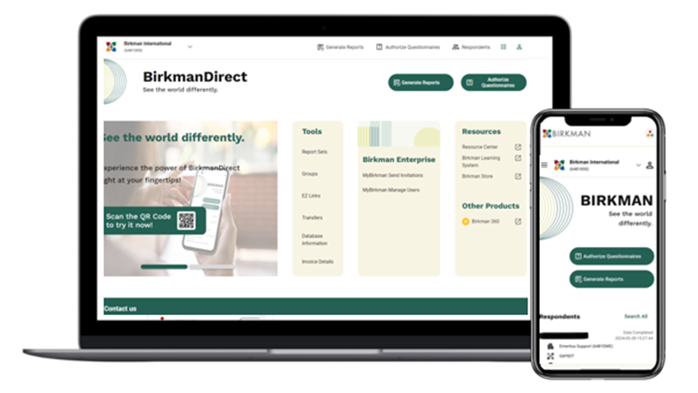
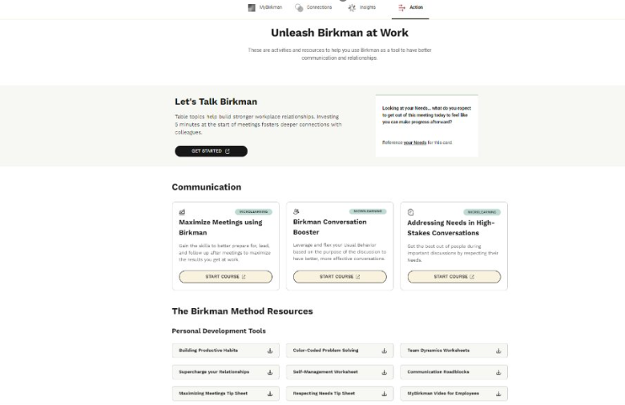
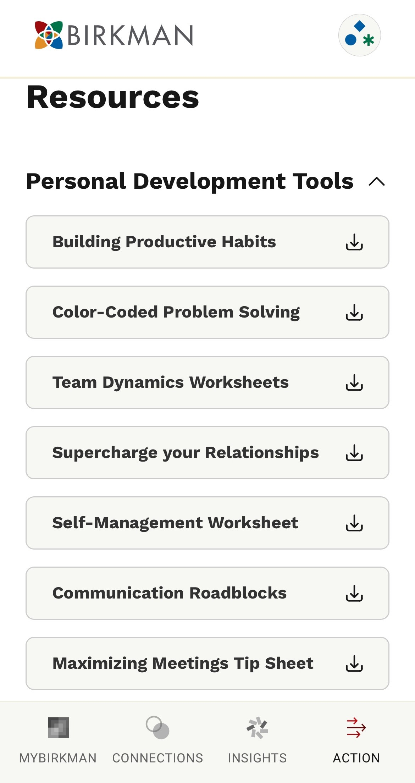

Slide 3
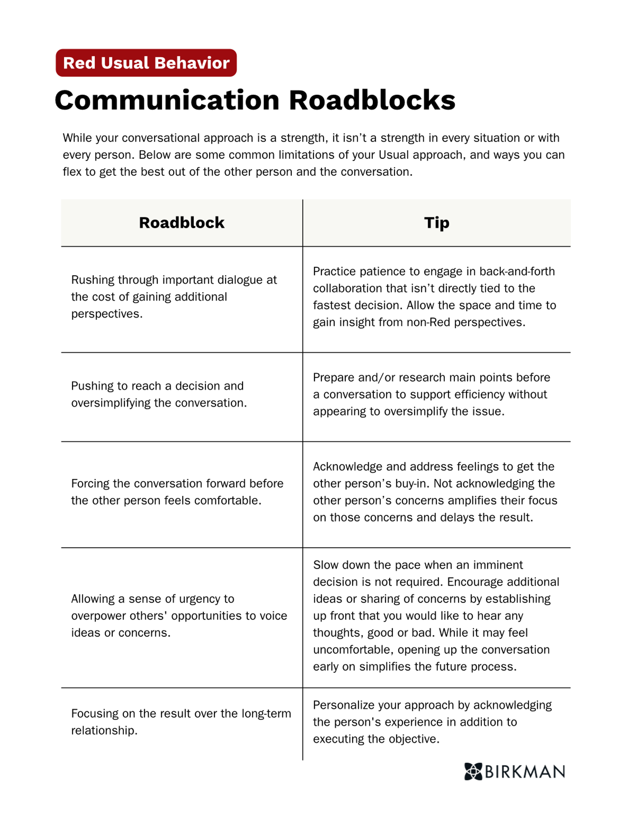
What barriers might your usual style create in conversations?
Let’s look at some practical tips for flexing your style…

Slide 4
Discussion Questions: 10 Minutes
1
As a group, review the roadblocks and tips.
2
Think of a conversation that didn’t go as planned. Which tip can you implement next time this happens?
3
Designate a spokesperson to share an aha moment from your group.

