Slide 1
Preparation Before the Workshop
Make sure all participants have taken the questionnaire and have access to their MyBirkman platform.
Make a Team Go to MyBirkman > Connections > Teams and click on “CREATE A NEW TEAM.” Add the Title and Description and click NEXT. Then click ADD on the team members and click DONE when you are finished adding. Take a screenshot of the Team Usual Behavior and add it to Slide 15, and a screenshot of the Team Needs and add it to Slide 20.
For Virtual Workshops, create breakout rooms for each Birkman Color. Rename the rooms, RED, GREEN, BLUE, and YELLOW. If you have more than 10 people in a Color, create an extra breakout room to accommodate the discussion.
For In-Person Workshops, decide ahead of time where each Color group will breakout within the room.

Slide 2
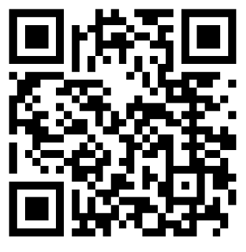
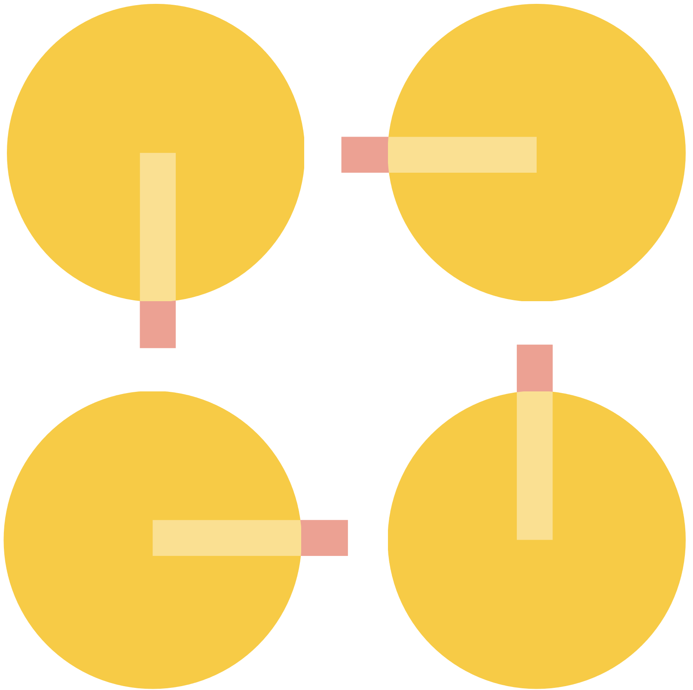
Welcome!
Please complete this 30 second survey.
See the world
differently.
Notes:
Time – 90 minutes
Your company is launching the MyBirkman platform.
This workshop is an “activating event” designed to further help bring your Birkman experience to life.

Slide 3
What is MyBirkman?
Kick-Off Workshop
See the world
differently.
Notes:
Time – 90 minutes
Your company is launching the MyBirkman platform.
This workshop is an “activating event” designed to further help bring your Birkman experience to life.

Slide 4
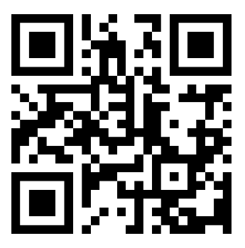
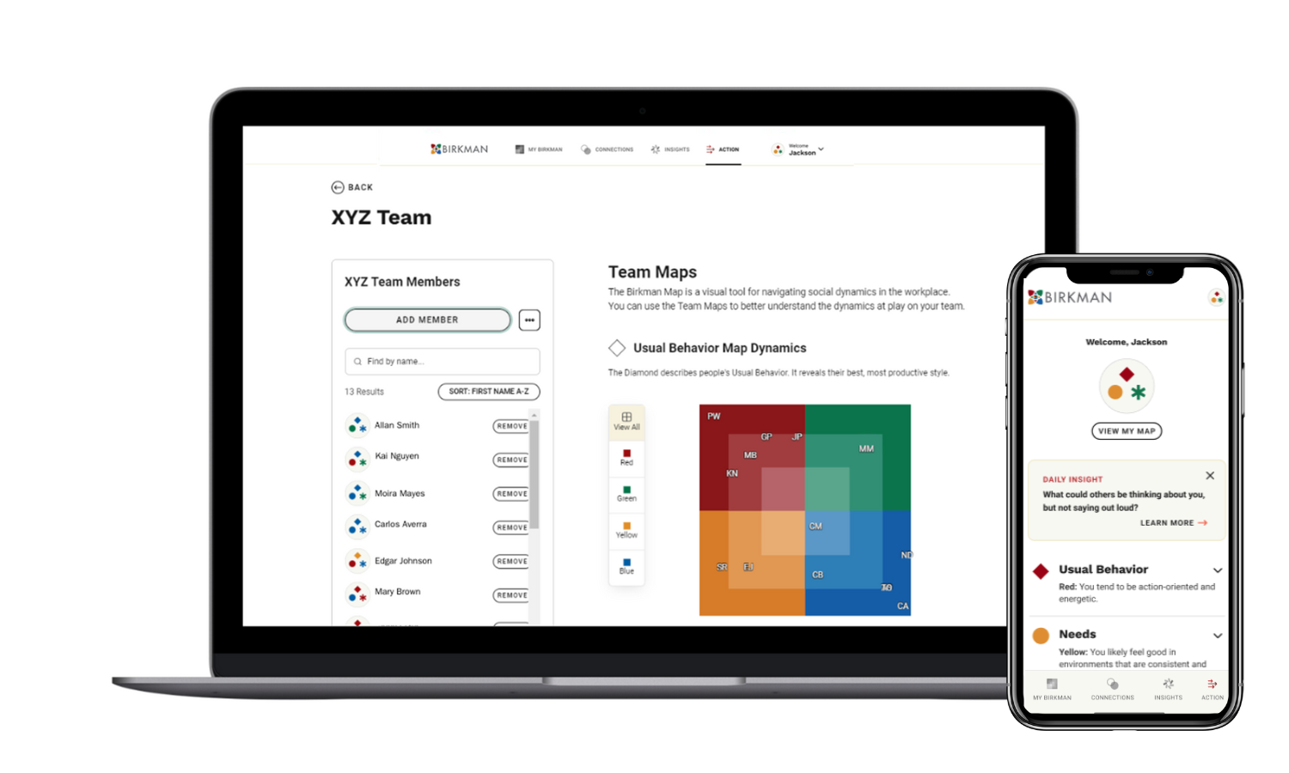
Notes:
Remind participants to have MyBirkman accessible on their phone or laptop to participate in the session.
If participants have not accessed MyBirkman yet:
Gain access to your results plus additional tools through MyBirkman.com
Search your email for an invitation from support@birkman.com.
Didn’t receive an email? Visit http://mybirkman.com and click “forgot password”
Click the link to create a password
“Pin” the webpage to your smart phone’s home screen

Slide 5
Session Agenda
1 | Introduction to Birkman
2 | Exploring Your Perceptions
3 | Unleashing Birkman at Work
4 | Session Takeaways
Notes:
Part of this session will be knowledge sharing and learning about Birkman concepts and the rest will be conversation among all of you.
Timing: Introduction to Birkman- 20 Minutes
Exploring Your Perceptions- 50 Minutes
Unleash Birkman at Work- 15 Minutes
Session Take-aways- 5 Minutes

Slide 6
The Birkman Method was created to help people see the world differently through the lens of personality.
Notes:
The Birkman Method was created to help people see the world differently through the lens of personality.
When we say see the world differently, there are two big things we mean by that.
See the World Differently reminds us of fundamental truth that we all have a unique perception and experience.
What one person sees as respect someone else may be frustrated or offended by the same gesture.
No two Birkmans are the same!
See the World Differently is an invitation to grow and challenge yourself to see the world differently from one day to the next. And we do that by getting curious.

Slide 7
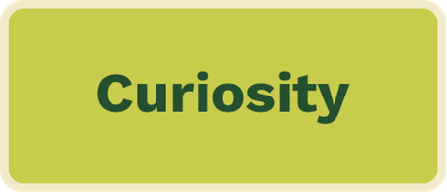
Curiosity is a state of mind.
Begin with a positive and productive outlook
Be open to exploring
Ask questions
Replace judgment with curiosity
Notes:
We are able to see the world differently by practicing being curious. Being curious allows us to create an environment focused on learning rather than judgment.
Curiosity is a state of mind.
Begin with a positive and productive outlook
Be open to exploring
Ask questions
Replace judgment with curiosity
https://walton.uark.edu/insights/replace-judgement-with-curiousity.php

Slide 8
Curiosity
Conversation
Connection
Why Birkman?
Notes:
We believe here at Birkman that curiosity is just the starting point. Curiosity leads us to have conversations which leads us to stronger connections. And stronger connections allow us to get more curious, and the cycle continues.
When we get exposed to Birkman, just like you were exposed to the SuperQ, it allows us to become more curious, because it visualizes our perceptions and personalities in ways that you can’t normally see. It allows us to appreciate that we all have our own unique point of view; that each of us only has one point of view, and once we realize that we get curious and start asking people about their experiences.
Asking is what starts the conversation. Curiosity is the spark and conversations are where our views begin to transform and how we begin to create deeper connection. This deeper connection starts the cycle again with more curiosity.
Birkman allows you to create deeper connections:
Between each other
Within your careers
And within yourselves
This is very important to feeling engaged in the workplace.

Slide 9
Connect through what makes you the same,
contribute through what makes you different.
The SuperQ
Lower Scores 1-49% | Higher Scores 50-99%
You see the world more similarly | You see the world more differently
How differently do you and _________ see the world?
Connections > Compare > SuperQ
Notes:
Time: 10 minutes
Individual Activity.
We are going to practice getting curious by exploring one of the data points in MyBirkman, the SuperQ.
Lower Scores 1-49% - You make sense of the world more similarly.
Higher Scores 50-99% - You see the world more differently in terms of motivations, expectations, and how you approach situations.
On each slide, you'll see an orange box indicating the section of MyBirkman we're focusing on.
To access the SuperQ, follow these steps: Navigate to Connections, then Compare, and finally SuperQ .
Take 3 minutes to look at the SuperQ for some of the people in this workshop.
When we come back together, we will discuss the following questions:
Who did you choose?
What was your SuperQ?
What was your impression or reaction?
Have several people answer the questions above.

Slide 10
Guiding Principles
No one person is better than another. We’re better together.
People are complex. Birkman accelerates learning about these complexities.
Birkman is a language. The more people who speak it, the better we can communicate together and understand each other.
You don’t take the Birkman once. You practice it every day.
Notes:
Here are a couple of guiding principles. While some of them may feel obvious, doing these things in the workplace takes another level of awareness and intention.
No one person is better than another. We’re better together.
People are complex. Birkman accelerates learning about these complexities.
Birkman is a language. The more people who speak it, the better we can communicate together and understand each other.
You don’t take the Birkman once. You practice it every day. MyBirkman gives you the opportunity to practice by having your data with you as well those around you.
Research shows we’re better together.
You don’t get the value out of diversity unless you value the diversity.

Slide 11
Exploring Your Perceptions
There are many layers to who you are.
USUAL BEHAVIOR
Your productive, strengths-based behavior.
NEEDS
Your expectations of other people and a typical environment.
INTERESTS
Your motivations and the type of work you find most energizing.
Notes:
There are many layers to who you are.
USUAL BEHAVIOR – The Diamond. It is your self-perception. How you see yourself or how others see you. It is visible to those around you. Your productive, strengths-based behavior.
NEEDS- The Circle - Your expectations of other people and a typical environment. Needs are our social perceptions. It is how we see the world, and what we expect from those around us. Needs are not seen by others.
Needs are a significant differentiator of The Birkman Method.
How you show up is often very different than your underlying Needs.
How you act is not always how you want to be treated. Yet people assume that we mirror their behavior when interacting with them!
INTERESTS – The Asterisk - Your motivations and the type of work you find most energizing. The more we do tasks associated with our higher Interests, the more motivated we will be.

Slide 12
The Birkman Map
The Birkman Map is a visual tool for navigating social dynamics in the workplace.
EXTROVERT
TASK-ORIENTED
PEOPLE-ORIENTED
INTROVERT
Notes:
The Birkman Map is a visual tool for navigating social dynamics in the workplace.
Orient yourself compared to other people. The Birkman Map shows us our behaviors, expectations, and motivations and how they compare to others.
The Birkman Map gives us a 10,000 ft view or a general summary of ourselves and others. Just like the GPS that shows us where to turn, it does not show all of the details of our route. The Birkman does the same thing, it will share some details about ourselves, but it will not share everything.
Explain axes
Extrovert vs. Introvert- People who have extroverted personalities tend to be more outgoing and sociable, with an assertive communication style. In contrast, people who have more introverted personalities tend to be reserved and quiet, with a more suggestive communication style. Introverts recharge more by being alone, compared to extroverts who recharge more by being with people.
Task vs. People Oriented- Task-oriented people are those who are concerned more with productivity and efficiency. They approach work in a factual, objective manner. In contrast, individuals who are more people-oriented are concerned with building relationships. They approach work in a more subjective, relational manner. Those who are people-oriented focus on the needs of others. Whereas the focus of those who are task-oriented is their to-do list and getting things accomplished. ​
Gradients
You may have noticed that in explaining the axes, we used the term “more”. The deeper the color where your symbol lies, the more of that color you will find in your symbol. The closer to the middle your symbol lies, the more of a mixture if the 4 colors you have.
Example: if any of my symbols fall in the upper right of the Map in the Green quadrant, then I can say that symbol has more Green in the mixture than other colors.
MyBirkman is custom to the location of your symbol!

Slide 13
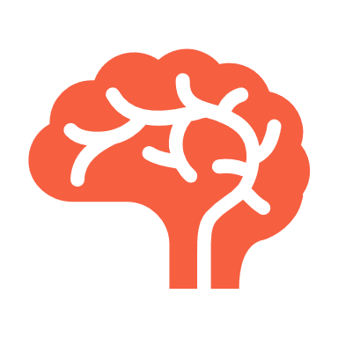
Usual Behavior
The Diamond represents your effective style in working and dealing with others.
Your natural, productive style
Who you are when you’re at your best
Your strengths
Behavior observable by others
How you show up
at work
Your reputation
Notes:
Let’s explore the layers we mentioned earlier, starting with Usual Behavior, which is represented by the Diamond on the Map.
The Diamond represents your effective style in working and dealing with others.
It is your natural productive style.
It can be described as your strength's behavior.
It is who you are when you are at your best.
It is how you show up at work.
It is your reputation.
It is behavior observable by others.
Our Usual Behavior is adaptive according to different situations for us to be effective.

Slide 14
Usual Behavior
Each Color has its own unique way of getting results at work.
RED USUAL
Active
Decisive
Practical
Direct communicator
GREEN USUAL
Responsive
Flexible
Enthusiastic
Group communicator
YELLOW USUAL
Consistent
Focused
Cautious
Fact-based communicator
BLUE USUAL
Reflective
Thoughtful
Supportive
One-on-one communicator
Notes:
Each Color has its own unique way of getting results at work.
Your Color is going to “color” how you approach work and gives an idea of where you lean in terms of your natural strengths.
*Read each of the Color descriptions.
The map helps us orient ourselves to others. You may begin to realize that some scores are opposites of each other.
Reds and Blues are opposites.
Yellow and Greens are opposites.
If you think of your Usual Behavior color, those diagonally located from you tend to show up differently than you do.

Slide 15
Get curious about your Color
Time: 5 minutes breakout discussion
Open the team you just created. Click on the color where your Name is located.
2. Within your group, discuss the following:
How does your Usual Behavior reflect the strengths you bring to your role on your team?
My Birkman > Connections > Teams
Notes:
Breakout Group Activity.
Time: 5 minutes + 5 minute debrief
Open the team you just created. Click on the color of your Diamond.
Join the group that reflects your Usual Behavior Diamond.
Within your group, discuss the following:
How does your Usual Behavior reflect the strengths you bring to your role on your team?
EXAMPLE: If a person has a YELLOW Usual Behavior and is working in HR, they might say that their attention to detail and detachment from emotions can be a strength in their role by creating policies and working objectively with tough situations.
Select someone to be the spokesperson for your Usual Behavior Color group to share your response to the prompt above.
When the participants return from the discussion, ask each group to share the strengths of their color.
Did anyone learn anything about another color from our discussion?

Slide 16
Needs
The Circle reveals the environments or interactions with others that allow you to feel most comfortable.
The support you require to feel your best
Expectations of people and
the environment
Key motivators
Rechargers
The way you act is not necessarily how you want to be treated
Invisible to others
Notes:
Let’s take a look at our next layer: Needs
The Circle reveals the environments or interactions with others that allow you to feel most comfortable.
Needs are the expectations of people and the environment around you.
The support you require to feel your best
Key motivators
Rechargers
Invisible to others
The way you act (Usual Behavior) is not necessarily how you want to be treated. We cannot predict the expectations or Needs of others based on the behavior we see. Birkman would say that if you based what someone expects on their Usual Behavior you would be wrong almost 70% of the time.

Slide 17
It feels frustrating when your Needs go unmet.
Notes:
Humans need water, but we don’t truly feel this need until it goes unfulfilled. This same thing is true for people when we think about our personality Needs.
For some people, one of their personality Needs could be that they need time alone. For these folks, having time either by themselves or with a very small group of one to two people allows them to refuel and recharge. However, they likely don’t think about the fact that they need time alone until they’ve had too much social interaction.

Slide 18
Needs
The Circle reveals the environments or interactions with others that allow you to feel most comfortable.
RED NEEDS
Direct authority
Outlet for energy
Clear-cut situations
GREEN NEEDS
Competition
Group interaction
Flexibility and varied activities
YELLOW NEEDS
Protection from interruptions
Detailed directions
Consistency
BLUE NEEDS
Time to reflect
Individual connection
Opportunities to express thoughts, feelings, or concerns
Notes:
What do Needs look like for each color?
For Red Needs, they expect direct authority, an outlet for energy, and clear-cut solutions.
For Green Needs, they expect competition, group interaction, and flexible, varied activities.
Blue Needs expects time to reflect, individual connection, and opportunities to express thoughts, feelings, or concerns.
Those with Yellow Needs expect protection from interruptions, detailed directions, and consistency.

Slide 19
Voicing Your Needs
Open the Birkman app to your Needs page. Note the color of your Circle.
Complete the following prompt:
It is frustrating when ________ (stressor). It would be helpful if _____ (Needs)
Example: It is frustrating when others ignore my concerns. It would be helpful if instead of brushing them aside, we had a space or time to discuss them.
MyBirkman > Needs > Explore Stressors
Notes:
Breakout Group Activity.
Time: 10 minutes + 5 minute debrief
You need to recreate the Breakout rooms for each color.
Have everyone go to the Needs > Shape Your Environment > Feeling Frustrated section of the MyBirkman Platform.
Everyone will now choose the color of your Circle on the Birkman Map.
In your group, you are going to complete the following prompt: It is frustrating when ________ (stressor). It would be helpful if _____ (Needs)
Example: It is frustrating when others ignore my concerns. It would be helpful if instead of brushing them aside, we had a space or time to discuss them.
Remind the groups to select someone to be their spokesperson.
Have each group share their prompts.

Slide 20
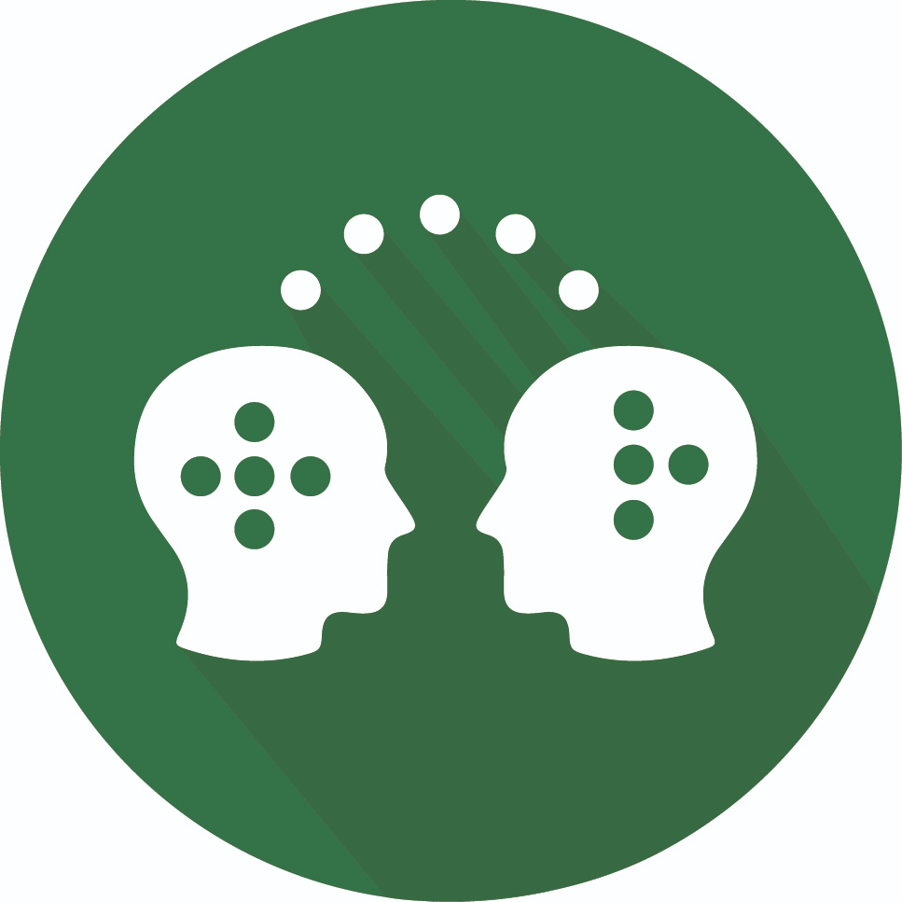
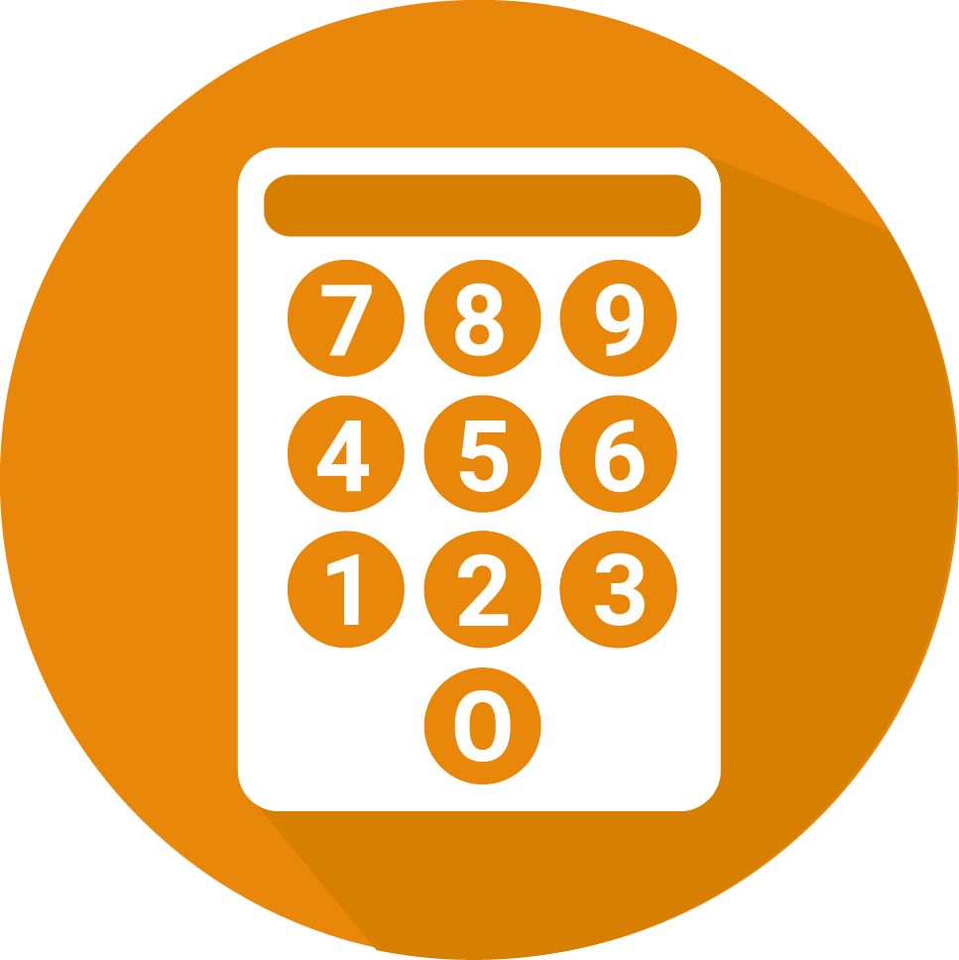
Interests
High scores indicate activities you enjoy. Low scores indicate areas you prefer to avoid. Interests don’t always translate to skill but do represent important motivators.
Outdoor
Scientific
Technical
Social Service
Persuasive
Administrative
Numerical
Artistic
Literary
Musical
My BIrkman > Interests > Interests Deep Dive
Notes:
Time: 15 Minutes
High scores indicate activities you enjoy. Low scores indicate areas you prefer to avoid. Interests don’t always translate to skill but do represent important motivators.
Go to your Interests section of MyBirkman by clicking on Interests and then Interests Deep Dive.
Birkman measures the same 10 Interests for everyone. The scale for Interests is 1-99. The higher the scores, the more motivated you are to engage in those activities. They can also be ways you de-stress or communication topics you want to engage in. Low scores indicate areas you want to avoid.
By understanding the activities that we are motivated by and understanding the activities that we are not as motivated by, Interests can help us figure out how we manage our time and what we do. By incorporating our Higher Interests into our work, we will find that we are more motivated to engage.
The Red Interests are Outdoor, Scientific, and Technical.
Outdoor
Motivated by activities conducted outdoors.
Places importance on connection to the outside environment
Likes activities outside of the office
Scientific
Curious about “why” things are the way they are
Places importance on intellectual curiosity
Likes to research, experiment, and investigate
Technical
Motivated to figure out how things work
Places importance on hands-on problem-solving
Gravitates toward machinery and technology
Will one person with Higher Red Interest share how this shows up in their work?
The Green Interests are Social Service and Persuasive.
Social Service
Motivated to advocate for others
Places importance on making a difference
Gravitates towards services that involve helping people.
Persuasive
Motivated to influence others to accept their ideas
Places importance on verbal communication to convince
Likes to debate, instruct, or sell
Will one person with Higher Green Interest share how this shows up in their work?
There are three Blue Interests: Artistic, Literary, and Musical
Artistic
Motivated by visual design
Emphasizes the importance of look and feel
Inspired through eye-catching aesthetics
Literary
Motivated to work with the written word
Appreciates the power of language
Finds inspiration in the language arts
Musical
Motivated by the musical arts
Places importance on the way things sound
Gravitates towards singing or playing instruments
Will someone with Higher Blue Interest share how this shows up in their work?
Yellow Interests are Administrative and Numerical
Administrative
Motivated by systems and procedures
Places importance on predictable processes
Likes to implement and maintain systems
Numerical
Motivated by quantitative activities
Places importance on analytical problem-solving
Gravitates towards working with numbers
Will someone with Higher Yellow Interest share how this shows up in their work?

Slide 21
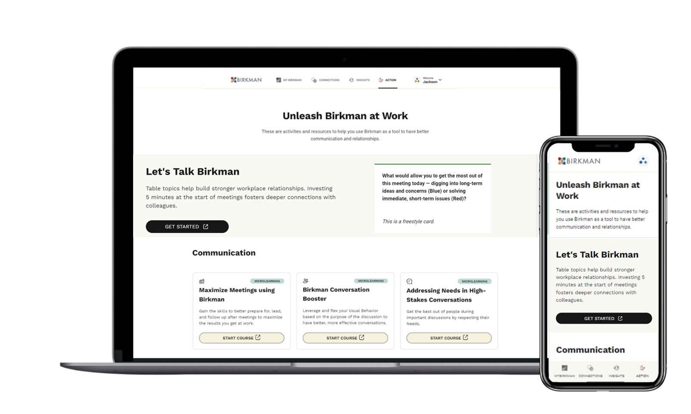
MyBirkman > Action
Notes:
Now that you have had a chance to explore the MyBirkman platform, you might be asking what is next or how I can keep being curious. We want you to go now and have conversations with others and we want to give you a few resources to help you in your conversations.
The last section of the MyBirkman platform helps you do just that. Click on the ACTION tab at the bottom of the platform.

Slide 22
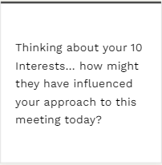
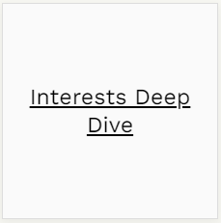
Let’s Talk Birkman Sample Card
FRONT
BACK
MyBirkman > Interests > Interests Deep Dive
Notes:
Let us now practice using one of the Action Page Resources. I have selected a card from the deck and wanted to spend a couple of minutes discussing these questions. The front of the card has the topic or question, and the back of the card has a link to which Birkman data is used to answer the question.
Open your MyBirkman to Interests, then Interests Deep Dive.
Think for a minute about this question:
How might your 10 Interests influenced how you approached this meeting?
EX: If someone has a higher Scientific Interest, their approach to this meeting may have been more of why this workshop exists or why we need this meeting?
Ask for a couple of people to share.
As you can see in only a few minutes, we have learned valuable information from one card. You can start meetings with one of these questions to continue discussing Birkman.

Slide 23
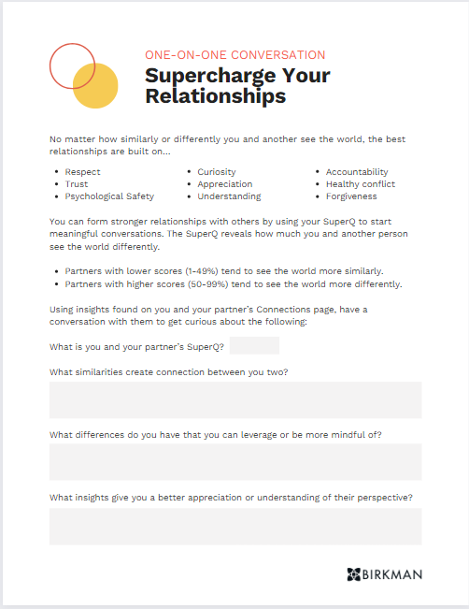
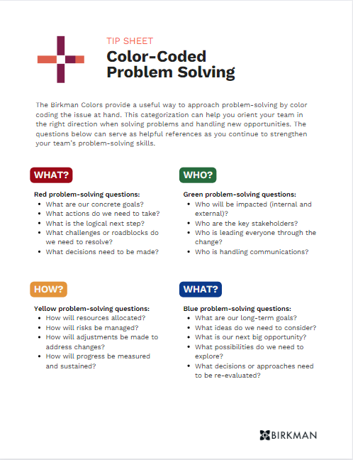
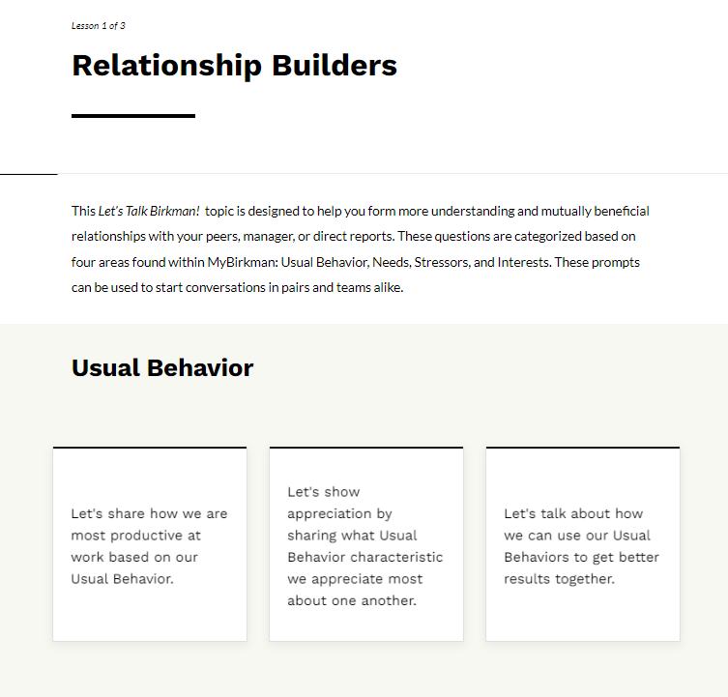
Action Page Resources
MyBirkman > Action
Notes:
Here are a few resources that you can check out.
Supercharge Your Relationships is a worksheet that uses the SuperQ score to explore how to create connections through similarities and leverage strengths through differences.
Color-Coded Problem-Solving is a useful way to determine what to focus on when solving a problem using different colors.
Let’s Talk Birkman - Relationship Builders is a user-friendly series of questions or statements that can effortlessly kickstart your one-on-one or group conversations.

Slide 24
Homework: Relationship Booster
With a colleague who has access to MyBirkman, use the Compare pages to get curious about your working relationship.
What similarities create a natural connection between the two of you?
What differences make each of you unique?
Possible conversation points to explore:
SuperQ
Interests
Your Needs & Their Needs
My Birkman > Connections > Compare
Notes:
If time allows, break the participants into pairs to do the activity. If time is running out, use this slide to determine what to do next.
From here, the choice is up to you. You have great data points from the MyBirkman platform to help you unleash Birkman in your work; it begins with getting curious about your co-workers.
If time is running out, challenge the participants to have a conversation with a co-working using the Compare and/or Action page to build deeper connections.
If you are breaking up into partners, give 10 minutes to have the discussion, and have them report back what they learned.
In their breakouts, have them answer the following questions:
What similarities create a natural connection between you?
What differences make each of you unique?

Slide 25
What was your biggest
aha moment or take-away?
Notes:
Workshop Wrap-Up Questions
What insights or surprises did you capture from this workshop?
How is this connected to the work that you do?

Slide 26
See the world
differently.

