Slide 1
Preparation before the workshop Organization Leader/Sponsor of Birkman Enterprise | Birkman Implementation Specialist
Delivers slides 2 - 7 and 28 - 31 | Delivers slides 8 - 27
Customize slides 2, 4, 7, 20, 25 and 31 to fit your organization's goals and objectives. | Schedule meeting with client to prepare for the presentation.
Create a Team Map in the MyBirkman platform of those participating in the workshop. Go to MyBirkman > Connections > Teams and click CREATE A NEW TEAM. Add the Title and Description and click NEXT. Click ADD for each team member Click DONE when you are finished. Take a screenshot of: - Team Usual Behavior; Add it to Slide 20 - Team Needs; Add it to Slide 25 | Support Organization Leader/Sponsor of Birkman Enterprise with the delivery of the workshop.
Determine the delivery method of the workshop: Virtual or in Person (no Birkman representative)
Review presentation to determine appropriate content and activities.
Meet to prepare for the presentation.
Send Meeting Invitation to participants – Refer to the Birkman Enterprise Success Toolkit (BEST) Communications for a meeting invitation template
If delivering in-person, determine where each Color group will breakout within the room.
For Virtual Workshops, create breakout rooms for each Birkman Color. Name the rooms, RED, GREEN, BLUE, and YELLOW. If you have more than 10 people in a Color, create an extra breakout room to accommodate the discussion.
PREPARATION BEFORE THE WORKSHOP

Slide 2

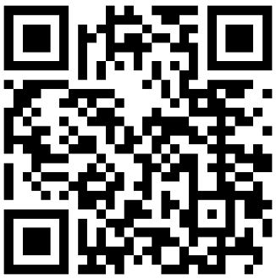


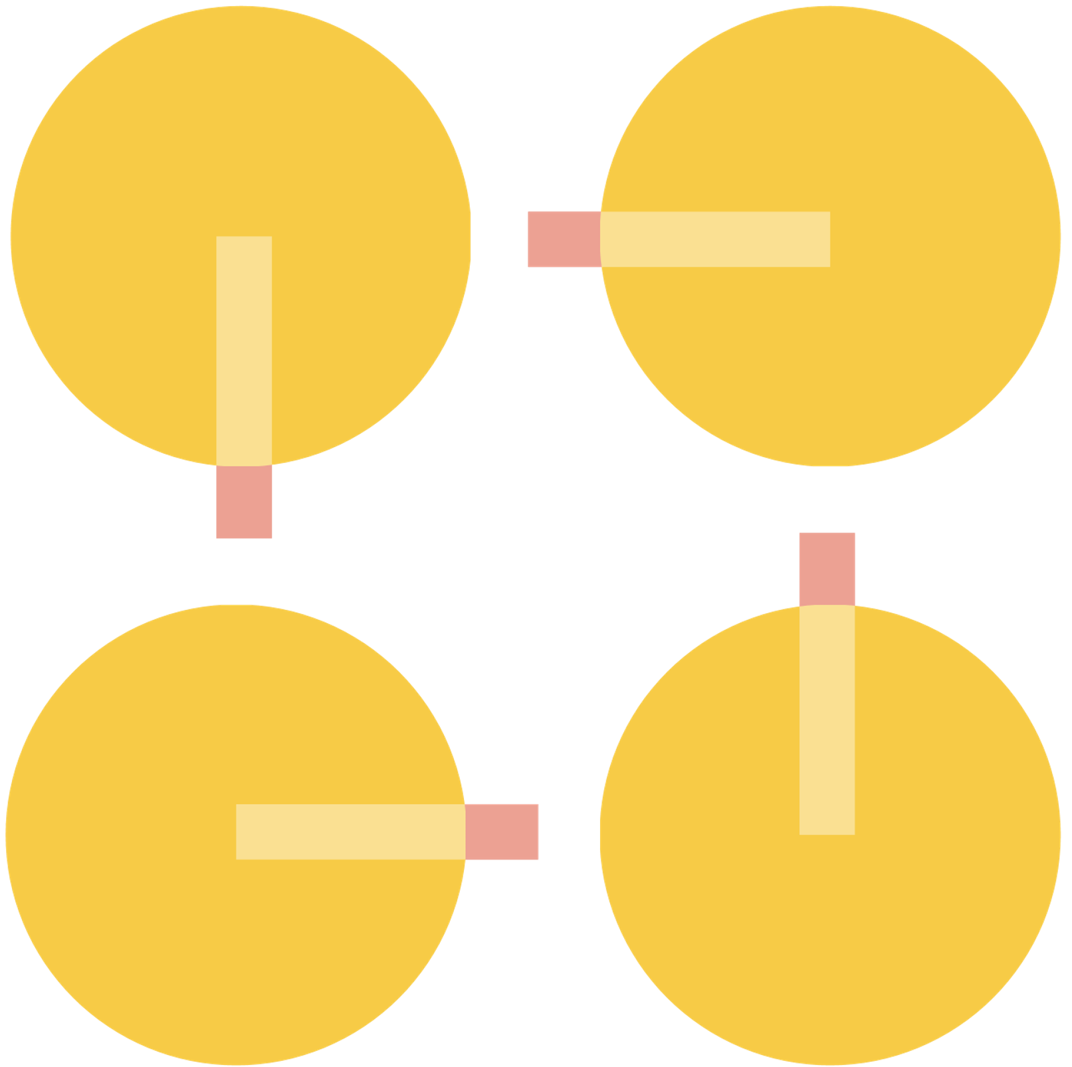
YOUR LOGO
Welcome!
Let’s start with a quick survey
See the world
differently.
Notes:
Section Time – 10 minutes
Speaker – Organization Leader/Sponsor of Birkman Enterprise
Welcome the Champions and thank them for joining you. Introduce yourself and the Birkman Implementation Specialist
Explain that the purpose of the workshop is to introduce the Champions to Birkman Enterprise, explain the importance of their role in the success of implementing it at the organization and “activate" them to bring the Birkman experience to life within the organization using the MyBirkman platform and tools and resources.

Slide 3
YOUR LOGO
Introduction to
Birkman Enterprise
Kick-Off Workshop
See the world
differently.
Notes:
Section Time – 10 minutes
Speaker – Organization Leader/Sponsor of Birkman Enterprise
Welcome the Champions and thank them for joining you. Introduce yourself and the Birkman Implementation Specialist
Explain that the purpose of the workshop is to introduce the Champions to Birkman Enterprise, explain the importance of their role in the success of implementing it at the organization and “activate" them to bring the Birkman experience to life within the organization using the MyBirkman platform and tools and resources.

Slide 4
Agenda
1 | Our Organization and Your Role
2 | Introduction to Birkman
3 | Exploring Your Perceptions
4 | Next Steps
Notes:
Speaker – Organization Leader/Sponsor of Birkman Enterprise
Review the Agenda.
Explain that they will be learning about Birkman concepts and putting it into practice through activities and conversations using the MyBirkman platform.
This will serve as examples of how they can use in the moment and on the job after the workshop and generate excitement within the organization.

Slide 5

Birkman and [Insert name of your org]
Add your organization’s performance goals or results your organization is striving to accomplish with the investment in Birkman Enterprise OR use these suggestions if they meet your objectives.
Delete this note.
Elevate productivity
Reduce turnover
Ignite employee engagement
Enhance collaboration within teams and across departments
Improve communication between people
Notes:
Speaker – Organization Leader/Sponsor of Birkman Enterprise
Provide the champions with an overview of your organization’s performance goals or results your organization is striving to accomplish with the investment in Birkman Enterprise.

Slide 6
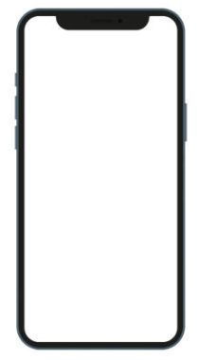

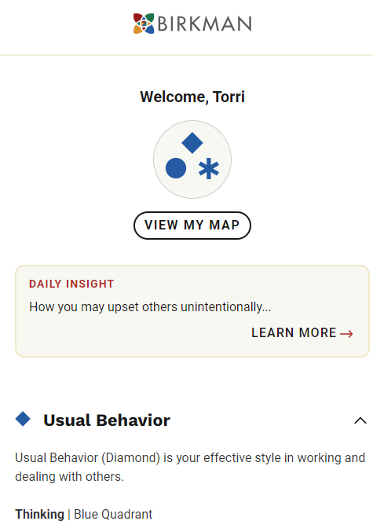


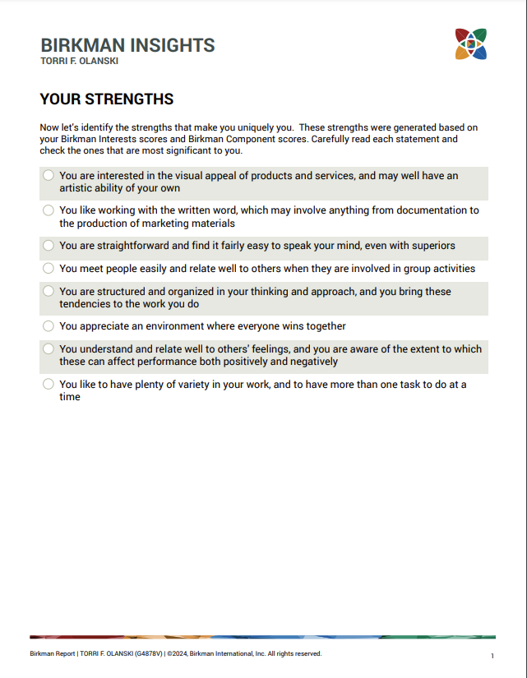
What is Birkman Enterprise?
Q
MyBirkman access for employees
The Birkman Method Questionnaire
Workshops and resources
Birkman personality reports
The Birkman Method Certification
Notes:
Speaker – Organization Leader/Sponsor of Birkman Enterprise
Explain that Birkman Enterprise includes:
The Birkman Method Questionnaire – the foundation by which the data is derived for employees so they can all connect through Birkman insights
MyBirkman platform for employees that is easily accessible on their laptop, tablet, or phone
Team workshops and toolkits through MyBirkman they can use to tackle specific challenges and improve their communication and team effectiveness
Birkman Certified Professional(s) [inform them of what that is/will be in your organization] who will provide ongoing learning and support
Birkman reports that address specific dimensions as needed will be delivered by the Birkman Certified Professional.

Slide 7
The Birkman Method was created to help people see the world differently through the lens of personality.
Notes:
Speaker –Birkman Implementation Specialist
The Birkman Method was created to help people see the world differently through the lens of personality.
And when we say see the world differently, there are 2 big things we mean by that.
See the World Differently reminds us of fundamental truth that we all have a unique perception and experience.
What one person sees as respect someone else may be frustrated or offended by the same gesture.
No two Birkman’s are the same!
“See the World Differently” is an invitation to grow and challenge yourself to see the world differently from one day to the next. And we do that by getting curious.

Slide 8
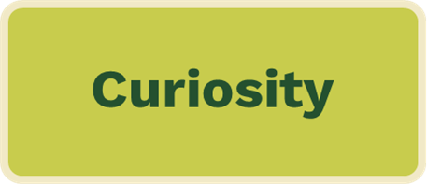
Curiosity is a state of mind.
Begin with a positive and productive outlook
Be open to exploring
Ask questions
Replace judgment with curiosity
Notes:
Speaker –Birkman Implementation Specialist
We are able to see the world differently by practicing curiosity. Being curious allows us to create an environment focused on learning rather than judgment.
There are days when this frame of mind feels second-nature, and others (maybe my cranky days) when I have a harder time with this. Birkman helps me have more curious days than judgmental days.
Curiosity is a state of mind.
Begin with a positive and productive outlook- valuing differences
Be open to exploring- I have a limited perspective and am curious to learn from others
Ask questions- what can I learn here?
Replace judgment with curiosity- expands our experience and opens us up to new possibilities
https://walton.uark.edu/insights/replace-judgement-with-curiousity.php

Slide 9
Curiosity
Conversation
Connection
Why Birkman?
Notes:
Speaker –Birkman Implementation Specialist
So why Birkman? Birkman has been around since 1951, over 70 years! So why do people continue to benefit from Birkman insights?
Because it sparks connection, which leads to more productive and positive experience.
So we just practiced this..
Curiosity is the spark, and conversations are where our views transform, which creates deeper connections. This deeper connection starts the cycle again with more curiosity. ”I know someone like that”
Less judgement, more curiosity – it’s instrumental in a well functioning, healthy, engaged workplace.

Slide 10
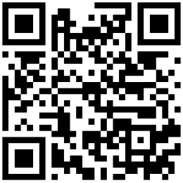
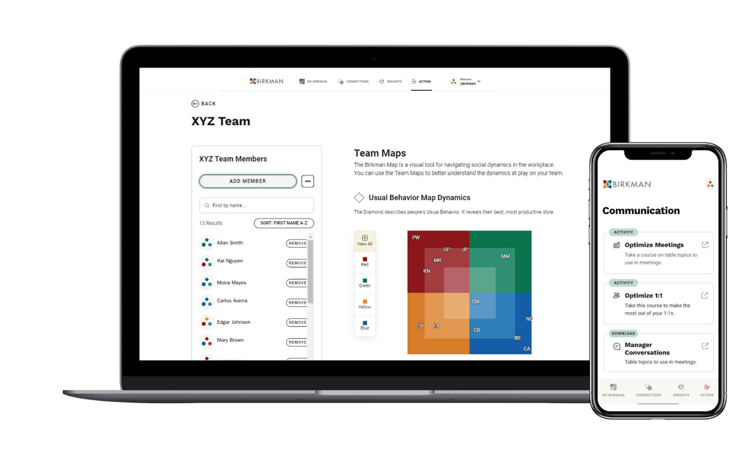
"Pin" MyBirkman to Your Phone
iPhone
Open Safari and visit mybirkman.com
Tap the Action button (the square button with the arrow pointing upwards).
Tap Add to Home Screen.
Tap Done
Android
Open Chrome and visit mybirkman.com
Tap the three vertical dots to the right of the address bar
Tap Add to Home Screen.
Name the icon “MyBirkman”
Tap Add
Notes:
Before the workshop, as people are getting into the Zoom, ask them to get onto MyBirkman platform and "pin" it to their homescreen.
If participants have not accessed MyBirkman yet:
Gain access to your results plus additional tools through MyBirkman.com
Search your email for an invitation from support@birkman.com.
Didn’t receive an email? Visit http://mybirkman.com and click “forgot password”
Click the link to create a password
“Pin” the webpage to your smart phone’s home screen
iPhone or iPad
Open Safari and visit the website (https://mybirkman.com).
Tap the Action button (the square button with the arrow pointing upwards).
Scroll down and tap Add to Home Screen.
Tap the Done button. The icon should now be on your Home screen.
Android or Tablet
Open Chrome and visit the website (https://mybirkman.com).
Tap the three vertical dots to the right of the address bar to display the browser’s menu.
Tap Add to Home screen.
Give the shortcut icon a name like “MyBirkman”
Tap Add.

Slide 11
Guiding Principles
No one person is better than another. We’re better together.
People are complex. Birkman accelerates learning about these complexities.
Birkman is a language. The more people who speak it, the better we can communicate together and understand each other.
You don’t take the Birkman once. You practice it every day.
Notes:
Speaker –Birkman Implementation Specialist
Here are a couple of guiding principles. And while some of them may feel obvious, actually doing these things takes a healthy dose of awareness and intention.
No one person is better than another. We’re better together. You don’t get the value out of diversity unless you value the diversity.
People are complex. Birkman accelerates learning about these complexities. Birkman cuts the time it takes a team to get to know each other from an average of 18 months to 6 months.
Birkman is a language. The more people who speak it, the better we can communicate together and understand each other. "Birkmanese"
You don’t take the Birkman once. You practice it every day. MyBirkman gives you this data on the platform- in your pocket- relationship and workplace tools

Slide 12
Employees have the opportunity to..
Take the Birkman questionnaire
Explore the MyBirkman platform
Participate in workshops and manager-driven activities
Experience advanced development opportunities using certified Birkman reports
Feel more engaged and making a bigger impact in their job
Notes:
Speaker – Organization Leader/Sponsor of Birkman Enterprise
Explain the journey the Champions and employees will experience:
They take the Birkman Questionnaire
They then register for the MyBirkman platform and when given access, explore their insights and data and those of their colleagues
The organization will offer workshops and encourage people managers to use activities available through MyBirkman with their teams.
The certified Birkman professional at the organization will use certain reports as requested or indicated to provide advanced development opportunities
This will result in employees feeling more engaged and making a bigger more positive impact in their jobs!

Slide 13
Your Role as a Champion
Explain the expectations you have for the Champions with the roll out of Birkman Enterprise OR use these suggestions if they meet your objectives.
Delete this note.
Participate in Birkman Enterprise training.
Educate your colleagues and team about the power of this program
Demonstrate in 1:1 conversations and meetings how MyBirkman can be used to get to know one another’s similarities and differences to improve communication.
Share the resources you explored with others.
Continue to use Birkman Enterprise in your daily work after it’s launched across the organization.
Notes:
Speaker – Organization Leader/Sponsor of Birkman Enterprise
Explain why the Champions were selected and provide them with suggestions of how they can demonstrate the importance of using the tools.
Transition to Birkman Implementation Specialist (if applicable) - "Now, I'm going to turn it over to our Birkman Implementation Specialist, Claire and she's going to get us started on the MyBirkman platform which brings this all to life!"

Slide 14
What is MyBirkman?
See the world
differently.
Notes:
Speaker –Birkman Implementation Specialist
Section Time: 75 minutes
Birkman Implementation Specialist - I took the Birkman assessment when I was a teen and grew up in a home that spoke “Birkmanese”. My mom used it in her practice and it was foundational for us on a personal level.
This workshop is an “activating event” designed to help bring Birkman to life.
I am here to help you get Birkman up and running at your organization.
MyBirkman.com is where you will gain access to their results from the questionnaire and additional tools

Slide 15
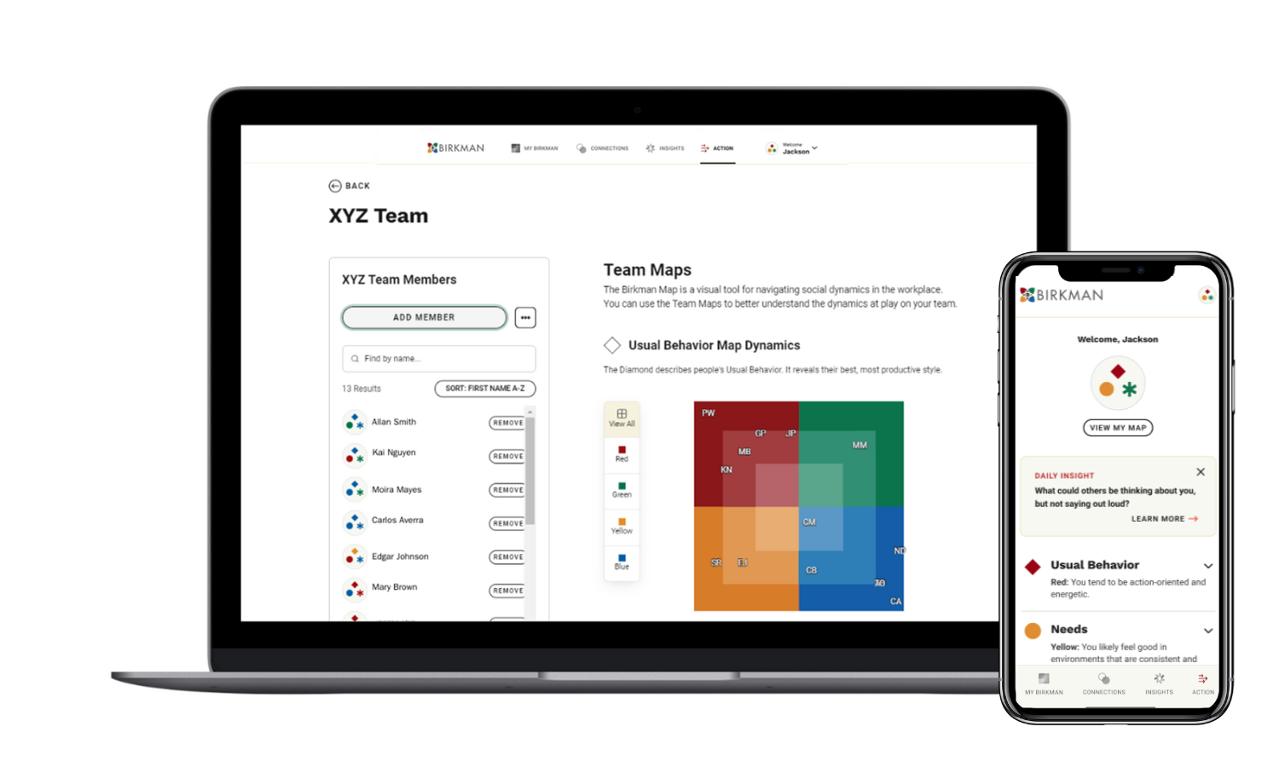
Notes:
Remind participants to have MyBirkman accessible on their phone or laptop to participate in the session.
If participants have not accessed MyBirkman yet:
Gain access to your results plus additional tools through MyBirkman.com
Search your email for an invitation from support@birkman.com.
Didn’t receive an email? Visit http://mybirkman.com and click “forgot password”
Click the link to create a password
“Pin” the webpage to your smart phone’s home screen
iPhone or iPad
Open Safari and visit the website (https://mybirkman.com).
Tap the Action button (the square button with the arrow pointing upwards).
Scroll down and tap Add to Home Screen.
Tap the Done button. The icon should now be on your Home screen.
Android or Tablet
Open Chrome and visit the website (https://mybirkman.com).
Tap the three vertical dots to the right of the address bar to display the browser’s menu.
Tap Add to Home screen.
Give the shortcut icon a name like “MyBirkman”
Tap Add.

Slide 16

Connect through what makes you the same,
contribute through what makes you different.
The SuperQ
Lower Scores 1-49% | Higher Scores 50-99%
You see the world more similarly | You see the world more differently
How differently do you and _________ see the world?
Connections > Compare > SuperQ
Notes:
Speaker –Birkman Implementation Specialist
Time: 3 minutes
Individual Activity.
Explain - For each of the activities we'll do today, you'll see an orange box indicating the section of MyBirkman we're focusing on.
We are going to practice getting curious by exploring one of the data points in MyBIrkman - the SuperQ.
To access the SuperQ, follow these steps: Navigate to Connections , then Compare, and finally SuperQ search for someone you'd like to compare your map to > Compare > SuperQ
Lower Scores 1-49% - You make sense of the world more similarly.
Higher Scores 50-99% - You see the world more differently in terms of motivations, expectations, and how you approach situations
>>Take 3 minutes to look at the SuperQ for some of the people on this call<<
When we come back together, we will discuss the following questions:
Who did you choose?
What was your SuperQ?
What was your impression or reaction?
Have several people answer the questions above.

Slide 17
Exploring Your Perceptions
There are many layers to who you are.
USUAL BEHAVIOR
Your productive, strengths-based behavior.
NEEDS
Your expectations of other people and a typical environment.
INTERESTS
Your motivations and the type of work you find most energizing.
Notes:
Speaker –Birkman Implementation Specialist
There are many layers to who you are.
USUAL BEHAVIOR – The Diamond. It is your self-perception. How you see yourself or how others see you. It is visible to those around you. Your productive, strengths-based behavior. How you “Sparkle”
NEEDS - Your expectations of other people and a typical environment. Needs are our social perceptions. It is how we see the world, and what we expect from those around us. Needs are not seen by others.
Need are a significant differentiator of The Birkman Method.
How you show up is often very different than your underlying Needs.
How you act is not always how you want to be treated. Yet people assume that we mirror their behavior when interacting with them!
INTERESTS - Your motivations and the type of work you find most energizing. Interests can also be communication filters and topics. The more we do tasks associated with our higher Interests, the more motivated we will be.

Slide 18

The Birkman Map
The Birkman Map is a visual tool for navigating social dynamics in the workplace.
EXTROVERT
TASK-ORIENTED
PEOPLE-ORIENTED
INTROVERT
Notes:
Speaker –Birkman Implementation Specialist
The Birkman Map is a visual tool for navigating social dynamics in the workplace.
Orient yourself compared to other people. The Birkman Map shows us our behaviors, expectations, and motivations and how they compare to others.
The Birkman Map gives us a 10,000 ft view or a general summary of ourselves and others. Just like the GPS that shows us where to turn, it does not show all of the details of our route.
Explain axes
Extrovert vs. Introvert- People who have extroverted personalities tend to be more outgoing and sociable, with an assertive communication style. In contrast, people who have more introverted personalities tend to be reserved and quiet, with a more suggestive communication style. Introverts recharge more by being alone, compared to extroverts who recharge more by being with people.
Task vs. People Oriented- Task-oriented people are those who are concerned more with productivity and efficiency. They approach work in a factual, objective manner. In contrast, individuals who are more people-oriented are concerned with building relationships. They approach work in a more subjective, relational manner. Those who are people-oriented focus on the needs of others. Whereas the focus of those who are task-oriented is their to-do list and getting things accomplished. ​
Gradients
You may have noticed that in explaining the axes, we used the term “more”. The deeper the color where your symbol lies, the more of that color you will find in your symbol. The closer to the middle your symbol lies, the more of a mixture if the 4 colors you have.
Example: if any of my symbols fall in the upper right of the Map in the Green quadrant, then I can say that symbol has more Green in the mixture than other colors.
MyBirkman is custom to the location of your symbol!

Slide 19






Usual Behavior
The Diamond represents your effective style in working and dealing with others.
Your natural, productive style
Who you are when you’re at your best
Your strengths
Behavior observable by others
How you show up
at work
Your reputation
Notes:
Speaker –Birkman Implementation Specialist
Let’s explore the layers we mentioned earlier, starting with Usual Behavior, which is represented by the Diamond on the Map. ​
​
The Diamond represents your effective style in working and dealing with others. ​
It is your natural productive style.​
It can be described as your strength's behavior.​
It is who you are when you are at your best.​
It is how you show up at work.​
It is your reputation.​
It is behavior observable by others. ​
​Our Usual Behavior is adaptive according to different situations for us to be effective.

Slide 20
Usual Behavior
Each Color has its own unique way of getting results at work.
RED USUAL
Active
Decisive
Practical
Direct communicator
GREEN USUAL
Responsive
Flexible
Enthusiastic
Group communicator
YELLOW USUAL
Consistent
Focused
Cautious
Fact-based communicator
BLUE USUAL
Reflective
Thoughtful
Supportive
One-on-one communicator
Notes:
Speaker – Birkman Implementation Specialist
Each Color has its own unique way of getting results at work.​
Your Color is going to “tint” how you approach work and shows where you lean in terms of your natural strengths.​
​
Note: Take a minute and read through each of the color descriptions. ​
​
The map helps us orient ourselves to others. You may begin to realize that some scores are opposites of each other. ​
Reds and Blues are opposites.​
Yellow and Greens are opposites.​
If you think of your Usual Behavior color, those diagonally located from you tend to show up differently than you do. ​

Slide 21
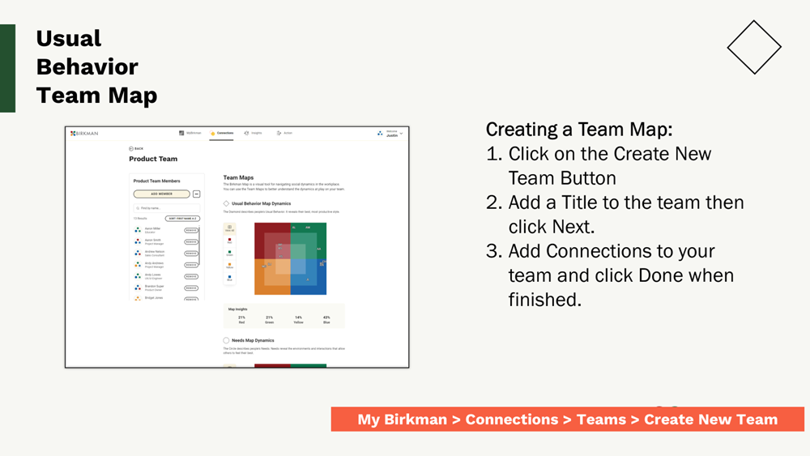
Notes:
Let’s practice!

Slide 22
Get curious about your Color
Time: 5 minutes breakout discussion
Open the team you just created. Click on the color where your Name is located.
2. Within your group, discuss the following:
How does your Usual Behavior reflect the strengths you bring to your role on your team?
My Birkman > Connections > Teams
Notes:
Breakout Group Activity.
Time: 5 minutes + 5 minute debrief
Represent your color! I’d love to hear from one of each of the colors:
How does your Usual Behavior reflect the strengths you bring to your role on your team?
EXAMPLE: If a person has a YELLOW Usual Behavior and is working in HR, they might say that their attention to detail and detachment from emotions can be a strength in their role by creating policies and working objectively with tough situations.
How you might use Team Map:
Obviously it’s a good idea to take a look or even print it out for the teams you most often work with.
Special projects or making decisions, look for your holes- you don’t necessarily need to find a color representative, but you can consider the topic from the vantage point from the missing color. “put on the hat”
When doing some of the activities in MyBirkman “Action” page, reference the team map

Slide 23







Needs
The Circle reveals the environments or interactions with others that allow you to feel most comfortable.
The support you require to feel your best
Expectations of people and
the environment
Key motivators
Rechargers
The way you act is not necessarily how you want to be treated
Invisible to others
Notes:
Speaker – Birkman Implementation Specialist
Let’s take a look at our next layer: Needs​
​
The Circle reveals the environments or interactions with others that allow you to feel most comfortable.​
Needs are the expectations of people and the environment around you.​
The support you require to feel your best​ and do your best
Key motivators​- when your needs are met, you’re able to show up in your best “usual” behavior style.
Invisible to others​
The way you act (Usual Behavior) is not necessarily how you want to be treated. We cannot predict the expectations or Needs of others based on the behavior we see.
Birkman would say that if you based what someone expects on their Usual Behavior you would be wrong almost 70% of the time. ​
​

Slide 24

It feels frustrating when your Needs go unmet.
Notes:
Speaker: Birkman Implementation Specialist
Humans need water, but we don’t truly feel this need until it goes unfulfilled. This same thing is true for people when I think about our personality Needs.
For some people, one of their personality Needs could be that they need time alone. For these folks, having time either by themselves or with a very small group of one to two people allows them to refuel and recharge.
However, they likely don’t think about the fact that they need time alone until they’ve had too much social interaction.

Slide 25
Needs
The Circle reveals the environments or interactions with others that allow you to feel most comfortable.
RED NEEDS
Direct authority
Outlet for energy
Clear-cut situations
GREEN NEEDS
Competition
Group interaction
Flexibility and varied activities
YELLOW NEEDS
Protection from interruptions
Detailed directions
Consistency
BLUE NEEDS
Time to reflect
Individual connection
Opportunities to express thoughts, feelings, or concerns
Notes:
Speaker –Birkman Implementation Specialist
Let’s a minute to read through each color. What do Needs look like for each color?​
​
For people with Red Needs, they expect direct authority, an outlet for energy, and clear-cut solutions.​
Those with Green Needs, expect competition, group interaction, and flexible, varied activities. ​
People with Blue Needs expect time to reflect, individual connection, and opportunities to express thoughts, feelings, or concerns.​
And those with Yellow Needs expect protection from interruptions, detailed directions, and consistency. ​
​

Slide 26
“Needs” Activity Option 1
Delete this note.
Voicing Your Needs
Time: 10 minutes
Open the Birkman app to your Needs page. Note the color of your Circle.
Join the group that reflects your Needs Circle.
Within your group, complete the following prompt:
It is frustrating when ________ (stressor), it would be helpful if _____ (Needs)
Example: It is frustrating when others ignore my concerns, it would be helpful if instead of brushing them aside, we had a space or time to discuss them.
Select someone to be the spokesperson for your Needs Color group to share your group’s response to the prompt above.
Needs > Shape Your Environment > Explore Stressors
Notes:
Note: Recreate the Breakout rooms for each color. ​
Speaker: Birkman Implementation Specialist
Breakout Group Activity.
Time: 10 minutes breakout + 5 minutes debrief
​Instruct everyone go to the Needs > Shape Your Environment > Feeling Frustrated section of the MyBirkman Platform. ​
Everyone will now choose the color of your Circle on the Birkman Map. ​
​In your group, you are going to complete the following prompt: It is frustrating when ________ (stressor). It would be helpful if _____ (Needs)​
​Example: It is frustrating when others ignore my concerns. It would be helpful if instead of brushing them aside, we had a space or time to discuss them.​
​Remind the groups to select someone to be their spokesperson. ​
Ask: Each group to share their prompts.

Slide 27
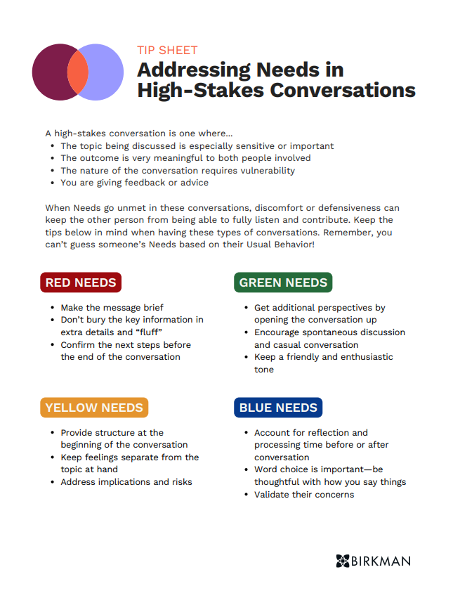
“Needs” Activity Option 2
Delete this note.
Needs Activity
Open the PDF “Respecting Needs Tip Sheet”
Read through Needs in your color quadrant
Discuss the following questions:
Which Needs feel true for you?
Can you recall a time in which a Need was or wasn’t met?
How can you get your Needs met going forward?
MyBirkman > Action > Respecting Needs Tip Sheet
Notes:
Breakout Group Activity.
Time: 10 minutes + 5 minute debrief
Remind the groups to select someone to be their spokesperson.
Have each group share.

Slide 28






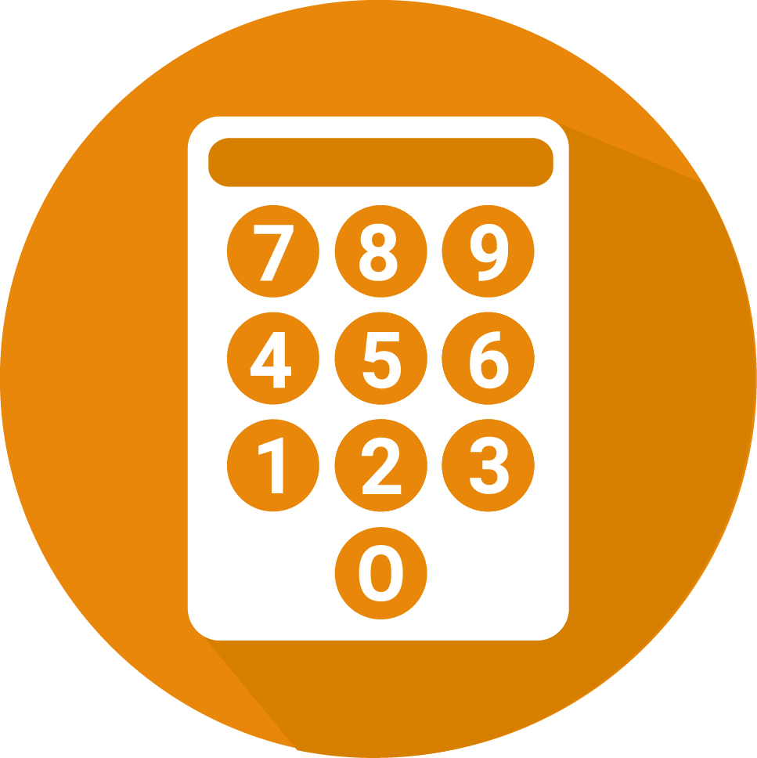



Interests
High scores indicate activities you enjoy. Low scores indicate areas you prefer to avoid. Interests don’t always translate to skill but do represent important motivators.
Outdoor
Scientific
Technical
Social Service
Persuasive
Administrative
Numerical
Artistic
Literary
Musical
Notes:
Speaker –Birkman Implementation Specialist
Time: 15 Minutes
​Go to your Interests section of MyBirkman by clicking on Interests and then Interests Deep Dive.​
​
Birkman measures the same 10 Interests for everyone. The scale for Interests is 1-99. High scores indicate activities you enjoy. Low scores indicate areas you prefer to avoid. Interests don’t always translate to aptitude/skill but do represent important motivators.​ The higher the scores, the more motivated you are to engage in those types of activities. They can also be ways you de-stress or communication topics you want to engage in. Low scores indicate areas you want to avoid or may procrastinate.​
​
By understanding the activities that we are motivated by and understanding the activities that we are not as motivated by, Interests can help us figure out how we manage our time and what we do.
By finding ways to incorporate our Higher Interests into our work, we will find that we are more motivated to engage. ​
​
The Red Interests are Outdoor, Scientific, and Technical. ​
Outdoor ​
Motivated by activities conducted outdoors.​
Places importance on connection to the outside environment​
Likes activities outside of the office​
Scientific​
Curious about “why” things are the way they are​
Places importance on intellectual curiosity​
Likes to research, experiment, and investigate​
Technical​
Motivated to figure out how things work​
Places importance on hands-on problem-solving​
Gravitates towards machinery and technology​
​
Ask: Will someone with Higher Red Interest share how this shows up in their daily life?​
The Green Interests are Social Service and Persuasive. ​
Social Service​
Motivated to advocate for others​
Places importance on making a difference​
Gravitates towards services that involve helping people.​
Persuasive​
Motivated to influence others to accept their ideas​
Places importance on verbal communication to convince​
Likes to debate, instruct, or sell​
​
Ask: Will someone with Higher Green Interest share how this shows up in their work?​
​
Yellow Interests are Administrative and Numerical​
Administrative​
Motivated by systems and procedures ​
Places importance on predictable processes​
Likes to implement and maintain systems​
Numerical​
Motivated by quantitative activities​
Places importance on analytical problem-solving​
Gravitates towards working with numbers​
Ask: If you have a Higher Yellow Interest, please share an example of something that motivates you in this area at work.
There are three Blue Interests: Artistic, Literary, and Musical​
Artistic​
Motivated by visual design​
Emphasizes the importance of look and feel​
Inspired through eye-catching aesthetics​
Literary​
Motivated to work with the written word​
Appreciates the power of language​
Finds inspiration in the language arts​
Musical​
Motivated by the musical arts​
Places importance on the way things sound​
Gravitates towards singing or playing instruments​
​
Ask: Will someone with a Higher Blue Interest share what this looks like for you?​

Slide 29
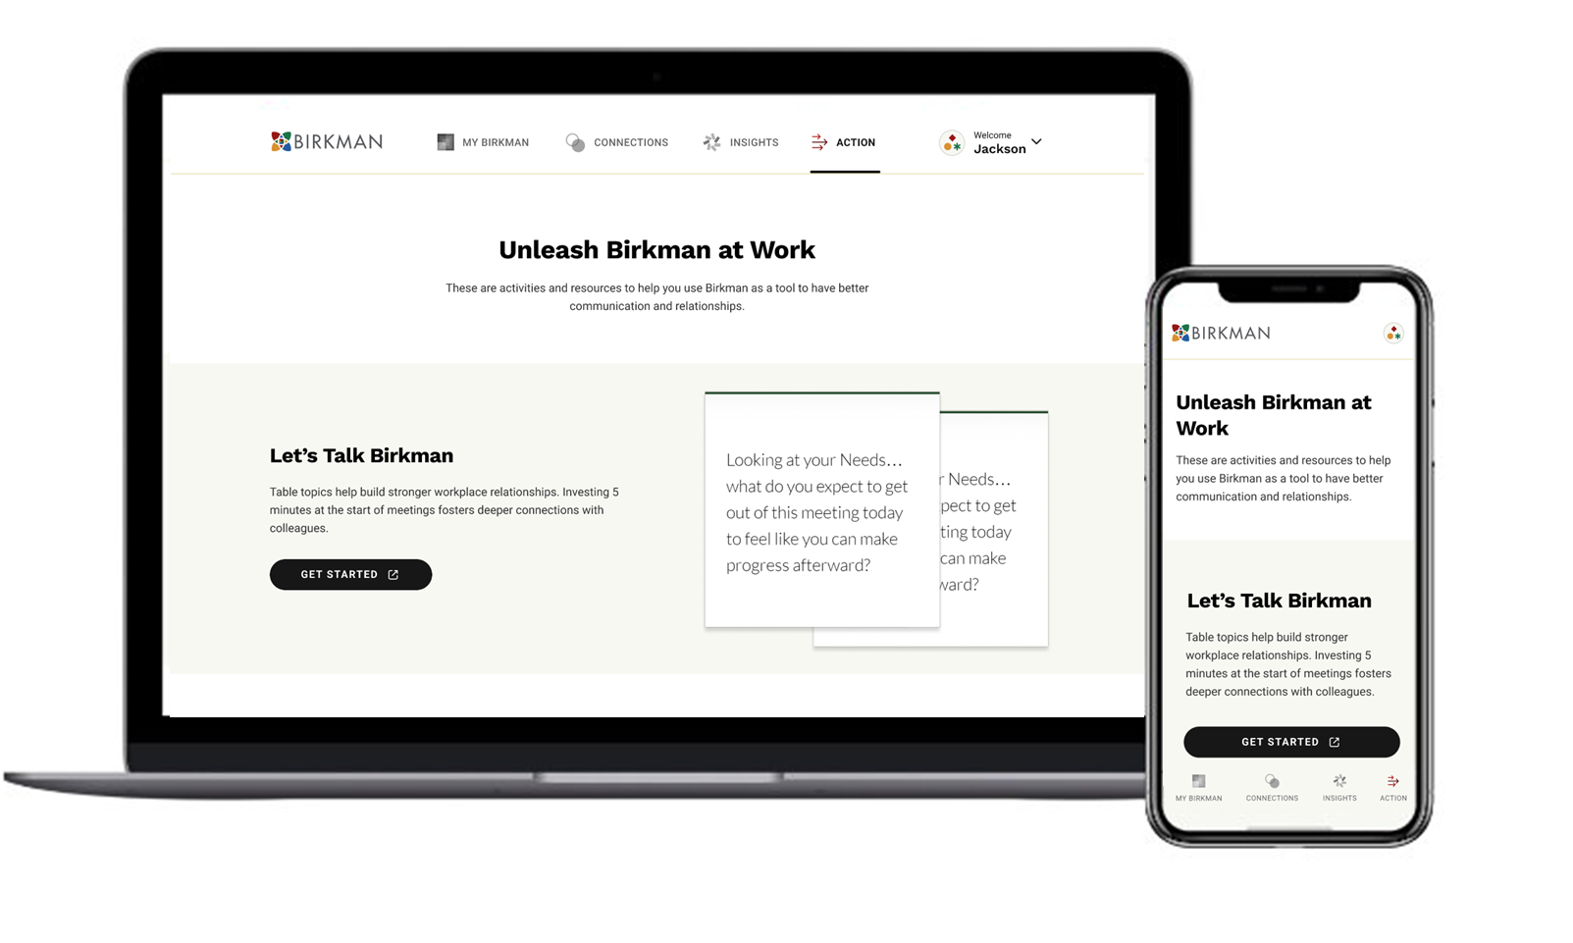
MyBirkman > Action
Notes:
Speaker: Organization Leader/Sponsor of Birkman Enterprise
Section Time: 5 minutes
Now that you have had a chance to explore the MyBirkman platform, you might be asking what is next or how I can practically fold this information into my routines and relationships
As champions, we want you to leave this workshop and use MyBirkman regularly. We want you to explore the resources to help you conversations and new routines. And we hope that you will share your excitement with others so that they look forward to trying it out themselves. ​
​
The last section of the MyBirkman platform helps you do just that. Click on the ACTION tab at the bottom of the platform.

Slide 30
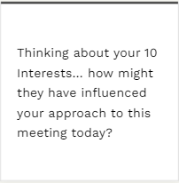
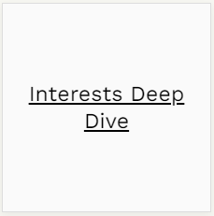
Let’s Talk Birkman Sample Card
FRONT
BACK
MyBirkman > Interests > Interests Deep Dive
Notes:
Let us now practice using one of the Action Page Resources. I have selected a card from the deck and wanted to spend a couple of minutes discussing these questions. The front of the card has the topic or question, and the back of the card has a link to which Birkman data is used to answer the question.
Open your MyBirkman to Interests, then Interests Deep Dive.
Think for a minute about this question:
How might your 10 Interests influenced how you approached this meeting?
EX: If someone has a higher Scientific Interest, their approach to this meeting may have been more of why this workshop exists or why we need this meeting?
Ask for a couple of people to share.
As you can see in only a few minutes, we have learned valuable information from one card. You can start meetings with one of these questions to continue discussing Birkman.

Slide 31
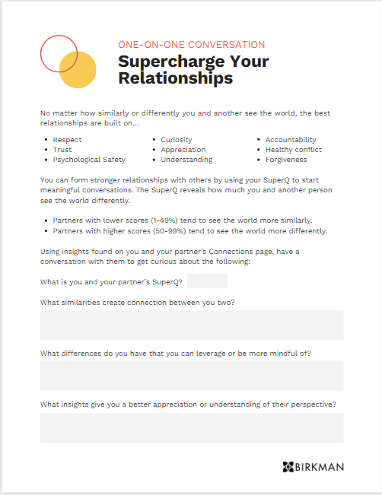
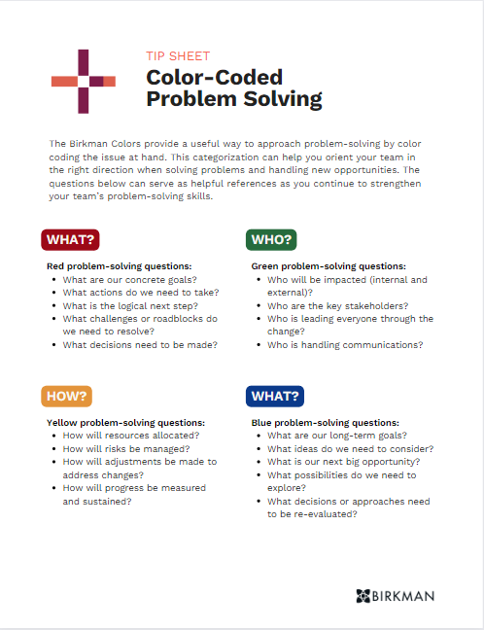
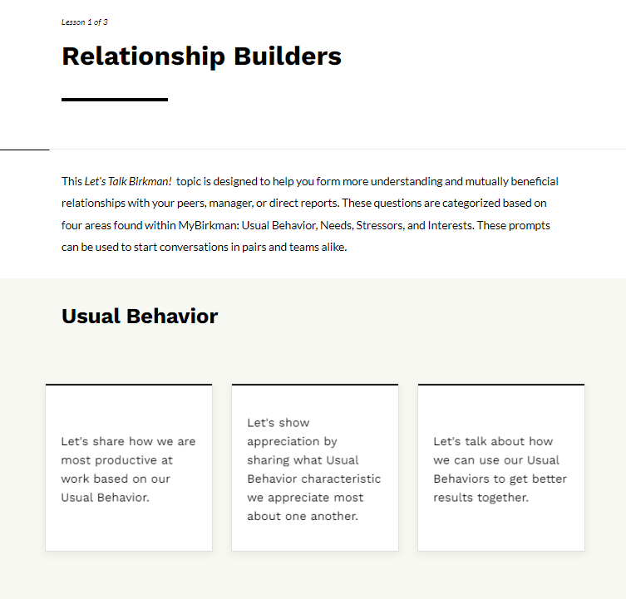
Action Page Resources
MyBirkman > Action
Notes:
Speaker: Organization Leader/Sponsor of Birkman Enterprise
Here are a few resources that you can check out.
Supercharge Your Relationships is a worksheet that uses the SuperQ score to explore how to create connections through similarities and leverage strengths through differences.
Color-Coded Problem-Solving is a useful way to determine what to focus on when solving a problem using different colors.
Let’s Talk Birkman - Relationship Builders is a user-friendly series of questions or statements that can effortlessly kickstart your one-on-one or group conversations.

Slide 32
What will you commit to doing to bring Birkman to life in our organization?
Notes:
Speaker: Organization Leader/Sponsor of Birkman Enterprise
Section Time – 5 minutes
Ask:
What insights or surprises did you capture from this workshop?​
How is this connected to the work that you do?
What will you commit to doing to bring Birkman to life in organization?

Slide 33
Consider giving your champions a specific assignment.
Delete this note.
Homework: Relationship Booster
With a colleague, use the Compare pages to get curious about your working relationship.
What similarities create a natural connection between the two of you?
What differences make each of you unique?
Possible conversation points to explore:
SuperQ
Interests
Your Needs & Their Needs
My Birkman > Connections > Compare
Notes:
If time allows, break the participants into pairs to do the activity. If time is running out, use this slide to determine what to do next.
From here, the choice is up to you. You have great data points from the MyBirkman platform to help you unleash Birkman in your work; it begins with getting curious about your co-workers.
If time is running out, challenge the participants to have a conversation with a co-working using the Compare and/or Action page to build deeper connections.
If you are breaking up into partners, give 10 minutes to have the discussion, and have them report back what they learned.
In their breakouts, have them answer the following questions:
What similarities create a natural connection between you?
What differences make each of you unique?

Slide 34
Next Steps
Add next steps Champions are expected to take OR use these suggestions if they meet your objectives.
Delete this note.
Educate your colleagues and team about the power of this program.
Use Connections to demonstrate in 1:1 how MyBirkman can be used to know one another’s similarities and differences and improve communication.
Explore Action Page resources and share the resources with others.
Continue to use the Birkman language in your daily work after it’s launched across the
Notes:
Speaker: Organization Leader/Sponsor of Birkman Enterprise
Turn it over to Tim and Drew.
The whole org will receive links to Birkman Questionnaire in the next day or two- please help encourage them to take it
Workshop to your whole org on June 10- Tim will lead

