Slide 1


INTERPRETATION TIP
Trust &
Psychological Safety
Using Birkman to improve trust and psychological safety begins with exploring perceptions. Our perceptions—how we each uniquely view ourselves and the world around us—greatly impacts how to build trust and psychological safety in the workplace. As a result, the ways trust and psychological safety can be built and broken for each person are as unique as the perceptions they hold. Birkman insights provide a roadmap for how to get started so there is less left up to chance. Explore the similarities and differences between trust and psychological safety below.
Trust | Psychological Safety
Can I count on you to follow-through on what you said you would do? One-to-one experience Will I give you the benefit of the doubt? Interpersonal vulnerability: trusting that someone won’t take advantage of you if you rely on them Built by keeping promises, showing competence, and demonstrating integrity Broken by betrayal, missed commitments, dishonesty, or inconsistent behavior | Do I feel safe to share my mistakes and opinions with this group? Group-level experience Will others give me the benefit of the doubt? Intellectual and emotional vulnerability: feeling safe to challenge ideas, share concerns, and innovate without facing embarrassment or punishment Built by welcoming input, encouraging healthy debate, responding supportively to mistakes or concerns Broken by fear, ridicule, punishment for speaking up, or exclusion from discussions

Slide 2
INTERPRETATION TIP
Exploring Trust
Using Birkman
Trust is the confidence employees have in the integrity, competence, and reliability of their colleagues and leadership.
Self Consciousness: Insights into Self-Consciousness Needs can help employees deliver messages in ways that don’t unintentionally break trust with them. Even when the facts of a conversation aren’t what someone will want to hear, they can still be said in a way that aligns with their expectations and don’t break trust from an interpersonal perspective. For example, those with an expectation for candid communication will often feel suspicious when people give too much context or extra “fluff” around a message. What builds trust for them is frank and forthright communication—getting right to the heart of the issue, even if to the deliverer it feels too honest or blunt. Conversely, those who prefer sensitive communication may not trust that people who are that candid with them have their best intentions in mind. This is because these individuals with higher Needs prefer others be in-tune to their story, carefully build up to the real issue, and take time for explanation, discussion, and validation.
Incentives informs how people expect to advance and be acknowledged in the workplace. Trust issues arise when individuals who prefer individualized recognition don’t feel rewarded for their unique input. Likewise, a person who desires a “group win” may become suspicious distrusting when it appears that others are just looking out for themselves. Insights into Incentives can be particularly helpful for managers to know about their employees so they are building trust with them in the right ways.

Slide 3
INTERPRETATION TIP
Exploring Psychological Safety
Using Birkman
Psychological Safety is a shared belief that team members can express ideas, questions, or concerns without fear of judgement or reprisal.
Emotional Energy: There is no “right amount” of emotional energy needed to create a psychologically safe environment. Instead, it will depend on the perceptions and Needs of those on the team to understand what allows each person to feel safe to take risks. For example, people who expect others to be open to emotional expression will begin to shut down if the team is sending signals that it’s best to keep emotions out of the conversation. In contrast, an environment that feels “messy and emotional” will feel uncomfortable for people who expect conversations to remain objective at all costs. Feeling this discomfort from either perspective doesn’t create a foundation for sharing and risk-taking.
Assertiveness: Psychological safety is about feeling comfortable voicing different opinions and admitting mistakes. Yet through Assertiveness we know that some people naturally speak up more than others. Thus, the focus of psychological safety issues should be on “silence when voice is necessary.” This occurs when people (regardless of Assertiveness score) don’t express their thoughts or concerns—even when it’s important—due to fear. If they do speak up, it will likely be in a counterproductive way, influenced by their Stress Behavior. In addition, exploring Assertiveness can ensure communication styles aren’t unintentionally undermining psychological safety. For instance, does a leader’s dominant speaking style discourage others from contributing? Or is the leader overly indirect, making it unclear whether differing opinions are truly welcome?
Social Energy: Psychological safety is a group-level construct, and Social Energy reveals that some people are more inclined towards interacting in groups than others. This doesn’t mean that people with higher Social Energy need more psychological safety, or the opposite. Instead, Social Energy gives insights into each person’s unique perceptions and how build a more psychologically safe environment for everyone. For example, consider how to approach building psychological safety for people with these different perceptions: “When I sense that I’m accepted by the group, I feel valued and safe to take risks.” compared to “When I have the opportunity to build close, one-to-one relationships with my team members, I feel more comfortable sharing when we all get together.”

Slide 4

ACTIVITY
Applying Emotional Energy & Assertiveness
to Psychological Safety
The Emotional Energy and Assertiveness Components can be useful tools to explore how to best build psychological safety in interpersonal relationships.
Assertiveness describes one’s tendency to speak up and express opinions openly. Psychological safety is about feeling comfortable voicing different opinions and admitting mistakes. Yet through Assertiveness, we know that some people naturally speak up more than others. Thus, the focus of psychological safety issues should be on “silence when voice is necessary.” This occurs when people (regardless of Assertiveness score) don’t express their thoughts or concerns—even when it’s important—due to fear. If they do speak up, it will likely be in a counterproductive way, influenced by their Stress Behavior. In addition, exploring Assertiveness can ensure communication styles aren’t unintentionally undermining psychological safety.
Similarly, Emotional Energy describes one’s openness and comfort with expressing emotion. Awareness of the interpersonal dynamics that result from Emotional Energy can help improve psychological safety levels in teams rather than contribute to the issue. There is no “right amount” of emotional energy needed to create a psychologically safe environment. Instead, it will depend on the perceptions and Needs of those on the team to understand what allows each person to feel safe and take risks.
This activity can begin a conversation about how individuals on a team create psychological safety and reveal what they expect from others to feel psychologically safe.
Materials:
Slide Deck
Blank Slide Handout (x1 per participant)
U/N/S report for Emotional Energy (x1 per participant)
U/N/S report for Assertiveness (x1 per participant)

Slide 5

ACTIVITY
Applying Emotional Energy & Assertiveness
to Psychological Safety
Steps:
Review the concepts of psychological safety and trust.
Describe the Emotional Energy and Assertiveness Components and how they relate to psychological safety.
Show a blank slide and explain that the goal of the activity is to create a statement to bring awareness to both our usual style and ways we feel most comfortable.
Provide an example slide and describe how this either builds or erodes your psychological safety. Share a personal story to connect the elements together. For example:
  Usual: I show up as expressive and suggesting. I’ve gotten comments before like “I can look at your face and tell what you’re thinking.” I find myself frequently being a sounding board for others, particularly when they are feeling sad or distressed.
  Needs: However, I prefer others to show up as practical and assertive. One time at work, I was feeling really upset about a change to a policy. My boss saw that I was upset and told me very directly that we needed to work it out. I shared my emotional reaction to the change and my boss listened kindly. Then they responded with the practical realities of why the change was happening and how little the change would change my day-to-day reality. This helped me get back on track.
Allow participants a few minutes to create their own statement.
Prompt participants to share their own stories of how they have experienced psychological safety when this has been true or how their sense of psychological safety has been impacted when it is not true.
Now that the participants know this about each other, what action steps can they commit to that can foster psychological safety with each other?

Slide 6

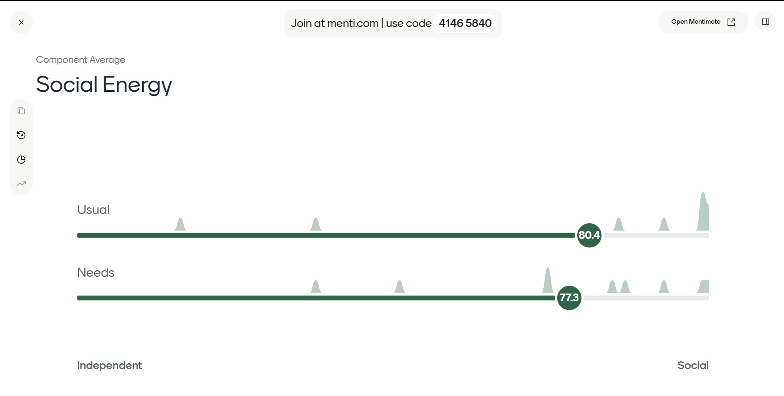
TECHNOLOGY TIP
Using Mentimeter
To Drive Engagement
Mentimeter is an online engagement tool that can add interactivity to your presentations. One way to add Birkman data real time is to create a live average for a Birkman Component using the Mentimeter Scale function. Here’s an example using Social Energy.
Step 1: Sign up for Mentimeter (it’s free).
Step 2: Create a New Menti.
Step 3: Choose “Start from scratch”.
Step 4: Choose “Scale”.
Step 5: Click on “Ask your Question here…” and write “Social Energy” in the header section of the slide canvas.
Step 6: Click on the Scale and replace “Statement 1” and “Statement 2” with “Usual” and “Needs” in the panel on the right.
Step 7: Remove Statement 3 by clicking the x next to it.
Step 8: Using the component anchor words, under Dimensions in the panel on the right, replace “Bottom of the Scale” with “Independent” and “Top of the Scale” with “Social”.
Step 9: Change the value of the top of the scale to 99 in the panel to the right.
*Note: It will warn you that this will remove the mid-value descriptor. That is okay!
Step 10: Present from Mentimeter or download the Powerpoint Add-in to add to your slideshow.
Remember to refresh after each presentation to use with different groups.
Want to learn more about Mentimeter? Click here to take a beginner course or here to see their how-to videos and helpful hints.

Slide 7

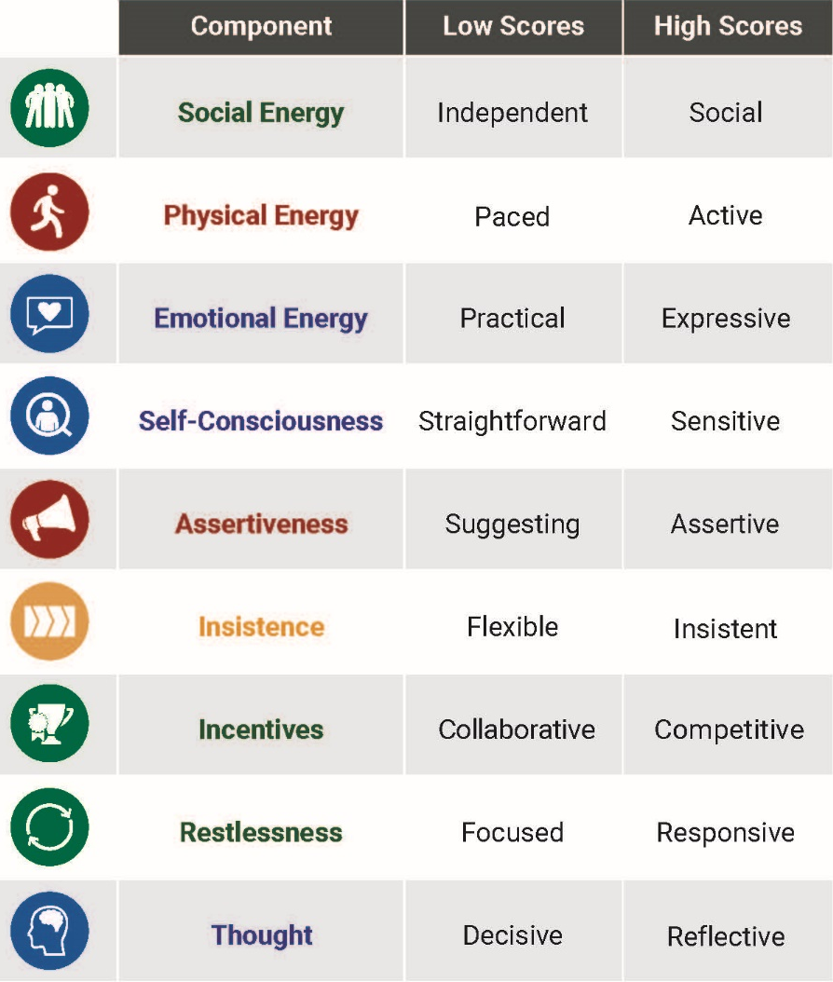
REFERENCE
Birkman Anchor Words
Component anchor words help your clients understand what the high and low end of the scale represent. It can also be a helpful mnemonic device to remember Needs, too. For Needs, add “need for” ahead of the description.
Example: Social Energy Usual Behavior: Independent/Social
Needs: Need for Independence/Need for Social Engagement

