Slide 1
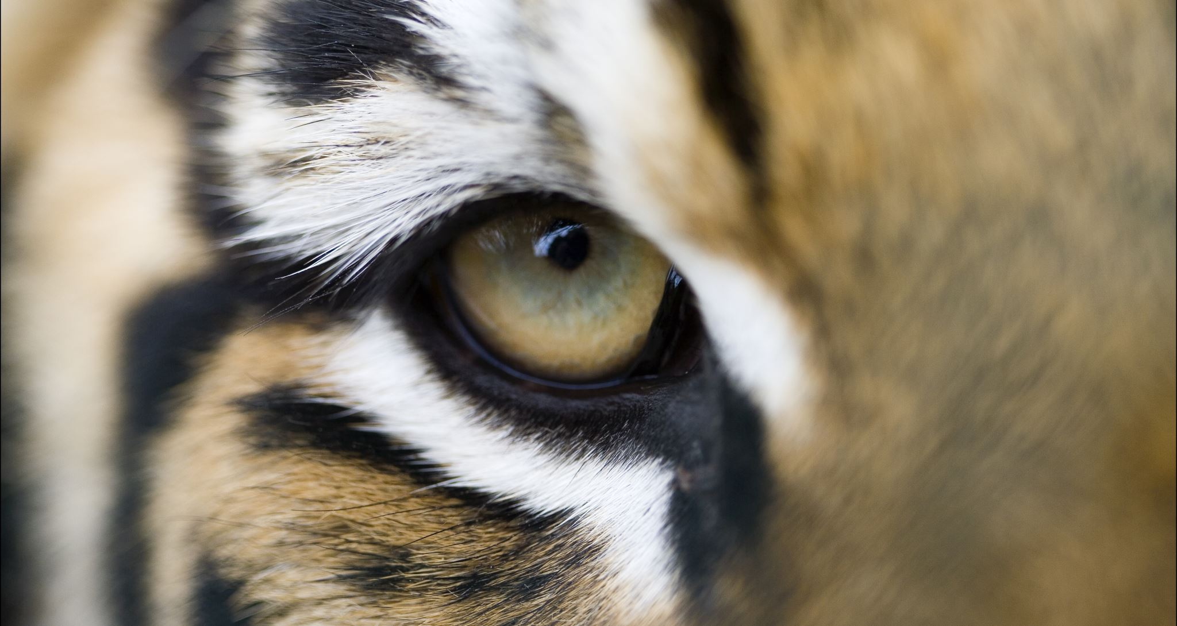


When We Don’t See Eye to Eye
…it’s normally a matter of perception.
The Birkman Map
Notes:
Focus: Using The Birkman Map as a tool for uprooting differences in perception.
Goal: Provide ways to use the Birkman Map in group or teams session to start conversations around conflict.

Slide 2

Notes:
Key concepts:
Each image is of the same location but filtered through a different season. This often happens in the workplace, where we are in the same place, but have a different experience based on our perception.
Where does this happen? In projects, in meetings, during conversations.
These differences in perception can lead to misalignments, tensions, and conflict.

Slide 3


Creating Dialogue in Conflict
Notes:
Key concepts:
The Birkman Map is a helpful tool to create dialogue around conflict as it visualizes these four different perceptions.
When We Don't See Eye to Eye:
Expose individuals to the idea that, "Some people may have a different perception than me, even though my perception feels to true".
Help shift judgment to, "How could there be value in seeing this a different way?"
Ask, "How can I use their different perception to help broaden my perceptive and strengthen our team?"

Slide 4
The Power of Perception
Usual Behavior
Your typical approach
Your productive behavior
Needs
Your expectations of others
Approaches that allow you to feel most comfortable
Notes:
Key concepts:
Usual Behavior and Needs influence our perception.
Usual Behavior – what I see as an effective approach
Needs – what my natural expectations are
When Usual Behavior and Needs are very similar, this will reinforce the perception of that Color.
When they are further apart on the Map, an individual's perception may be influenced by both Colors.

Slide 5
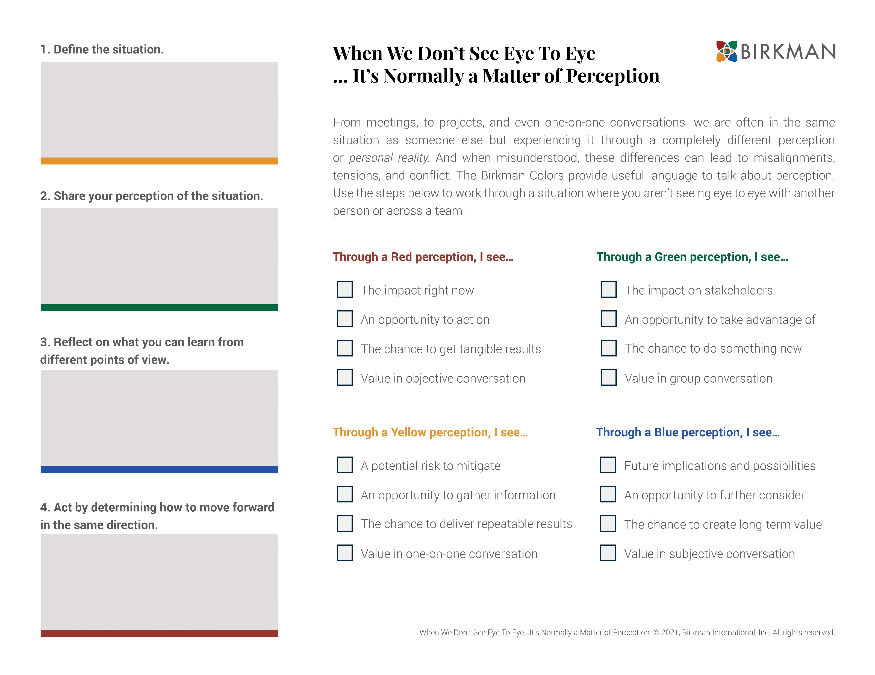
Looking Forward in the Same Direction

Slide 6

Define the Situation
Level set the conversation.
Where are we facing misalignments as a group?
Notes:
Key concepts:
We bring our rational brains to work (education, best practices, industry standards). Our invisible perceptions create a filter on top of all this!
We filter what we say and think through our perceptions without even realizing it!
Group session tip:
Ask for examples of where each person faces misalignments or conflict in their team or within their role.

Slide 7
Sharing What I See…
What is your perception of the situation at hand?
Explain your point of view in your own words.
Through a Red perception, I see...
The impact right now
An opportunity to act on
The chance to get tangible results
Value in objective conversation
Through a Green perception, I see…
The impact on stakeholders
An opportunity to take advantage of
The chance to do something new
Value in group conversation
Through a Yellow perception, I see…
The requirements and restraints
A potential risk to mitigate
The chance to deliver repeatable results
Value in one-on-one conversation
Through a Blue perception, I see…
Future implications and possibilities
An opportunity to further consider
The chance to create long-term value
Value in subjective conversation
Notes:
Key concepts:
Even though our perception feels so "obvious" or natural to us, a lot of the time it's not obvious to other people! This is why it is important to "share what you see".
Blue and Red see from very different perceptions, same as Green and Yellow. We often see tension between these Colors.
When stakes are high, and we have two people coming at a situation and they are not seeing eye to eye, they are probably not seeing value in their different points of view and likely seeing the other person as a hindrance to the project.
Group session tip:
Have each individual choose 1 or 2 statements that reflect their perspective of the situation.
Have each individual share and explain their point of view.
Note where there is alignment and misalignment in the different perspectives.
Different perceptions can all feel accurate and valid, and that is why it is so important to share them and shift from judging different perceptions to asking, “What can we learn from them?”.

Slide 8
Considering What I Don’t See…
What is one thing you learned by hearing a different perspective?
What do you see by looking from a new point of view?
Through a Red perception, I see...
The impact right now
An opportunity to act on
The chance to get tangible results
Value in objective conversation
Through a Green perception, I see…
The impact on stakeholders
An opportunity to take advantage of
The chance to do something new
Value in group conversation
Through a Yellow perception, I see…
The requirements and restraints
A potential risk to mitigate
The chance to deliver repeatable results
Value in one-on-one conversation
Through a Blue perception, I see…
Future implications and possibilities
An opportunity to further consider
The chance to create long-term value
Value in subjective conversation
Notes:
Key concepts:
Build off the sharing from the previous step.
Encourage participants to consider and discuss a perception that is different from their own. Talk about what they can learn from a different point of view.

Slide 9
From Awareness To Action
How can we ensure we all move forward in the same direction
given our different, valuable perceptions?
Commit to 2-3 actions as individuals or as a team to help generate positive action.
Create 3 Rules of Engagement before an important meeting to encourage perspective sharing.
Be intentional about considering the perceptions of all four Colors in every project.
Find a colleague who has a different perception from you and actively seek their opinions.
Notes:
Key concepts:
Encourage positive change and accountability by committing to action individuals or as a team.

Slide 10

When you share a
glimpse into your perception,
it does not guarantee that you and another
will see eye to eye, but for a moment it
creates the opportunity to look from
the same point of view.
Notes:
Key concepts:
When we can look from the same point of view, and replace judgement with curiosity, then we will be better as a result.

Slide 11
When We Don’t See Eye to Eye
…it’s normally a matter of perception.
The Birkman Map

