Slide 1
The Birkman Method
Behavioral and Occupational Assessment

Slide 2
Why Birkman is Better
Birkman is the only assessment that measures underlying Needs.
Contains both behavioral and occupational data in one assessment.
Birkman examines personality and perceptions in a social context.

Slide 3
Birkman measures underlying Needs
Needs:
What individuals crave from their environment and from the people around them. When someone’s Needs are met, they are fulfilled, engaged, and productive.
By understanding one’s own Needs, individuals are better able to recharge, stay motivated, and avoid Stress Behavior.
By understanding an employee’s Needs, a manager is able to provide the support to improve morale, increase productivity, and better facilitate communication.

Slide 4
One assessment contains both behavioral and occupational data
We measure how employees relate to the people around them through their communication style, giving insights into potential gaps in an organization’s communication or culture.
We have data on the typical Interests, Usual Behavior, and Needs of individuals in a variety of job fields.
Respondents can see how closely they match the complete personality profile of people tenured in different careers.

Slide 5
We examine personality and perceptions in a social context
Social context of a person’s behavior promotes better self management and awareness of their own extremes relative to social norms.
By seeing the ways others perceive the world, an individual can better respect and empathize with their colleagues.

Slide 6
Common Uses of Birkman
Birkman is popularly used for:
Leadership Development
Team Building
Sales & Negotiation
Talent Selection
Career Exploration
Birkman can benefit every stage of the employee lifecycle, and each of these categories have many applications that fit within it. For example, leadership transitions, high potential development, executive coaching, and succession planning all fit within the Leadership Development category.

Slide 7
Birkman Basics

Slide 8
Birkman Colors
With Birkman, color becomes shorthand for understanding fundamental differences between personality types.

Slide 9
What We Measure
USUAL BEHAVIOR
NEEDS
What others observe
Socialized behavior
Invisible to others
Motivates you
Ideal environment
STRESS BEHAVIOR
INTERESTS
Seen by others
Reactive, unproductive behavior
Occurs when our needs are not met over time
What you like
Activities you prefer

Slide 10
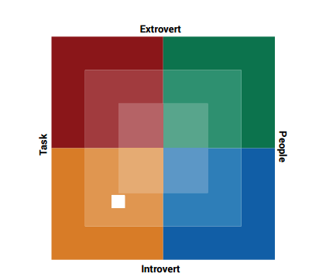
Birkman Map
Intensely Green
Moderately Green
A Blend of all colors

Slide 11
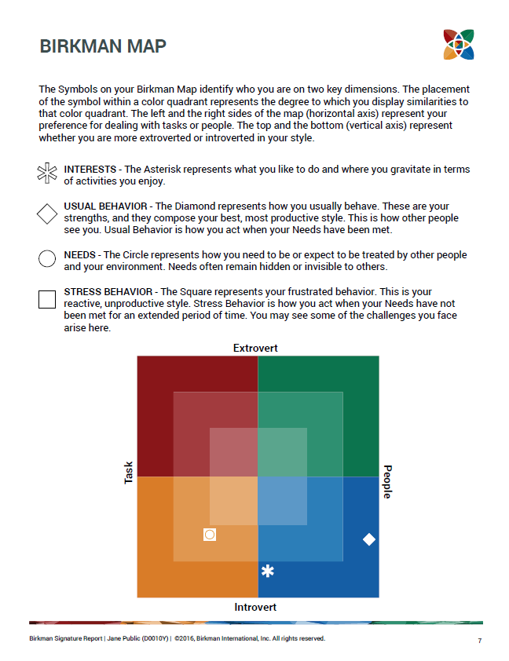
Birkman Map

Slide 12
Usual Behavior
The Diamond represents your Usual Behavior
RED USUAL BEHAVIOR
Practical
Active
Decisive
Candid
GREEN USUAL BEHAVIOR
Flexible
Sociable
Responsive
Competitive
YELLOW USUAL BEHAVIOR
Focused
Collaborative
Consistent
Independent
BLUE USUAL BEHAVIOR
Reflective
Tactful
Expressive
Suggestive

Slide 13
Needs
The Circle represents your Needs
RED NEEDS
Direct authority
Outlet for energy
Clear-cut situations
GREEN NEEDS
Recognition
Group interaction
Flexibility and varied activities
YELLOW NEEDS
Protection from interruptions
Detailed directions
Consistency
BLUE NEEDS
Opportunities to express feelings
Time for reflection
Respect

Slide 14
Stress Behavior
The Square represents your Stress Behavior
RED STRESS BEHAVIOR
Become impatient
Dismiss others’ feelings
Be busy for the sake of it
GREEN STRESS BEHAVIOR
Fail to follow the plan
Easily distracted
Distrust others
YELLOW STRESS BEHAVIOR
Rigid and overly insistent on rules
Reluctant to confront others
Resistant to change
BLUE STRESS BEHAVIOR
Find it hard to take action
Discouraged
Indecisive

Slide 15
Interests
The Asterisk represents your Interests
RED INTERESTS
Building
Solving problems
Seeing finished products
Working with your hands
GREEN INTERESTS
Promoting
Motivating
Selling and persuading
Working with people
YELLOW INTERESTS
Developing procedures
Working with numbers
Scheduling activities
Analyzing details
BLUE INTERESTS
Visual appeal of designs
Involvement of music
Using words or stories to communicate

Slide 16
Birkman Signature

Slide 17
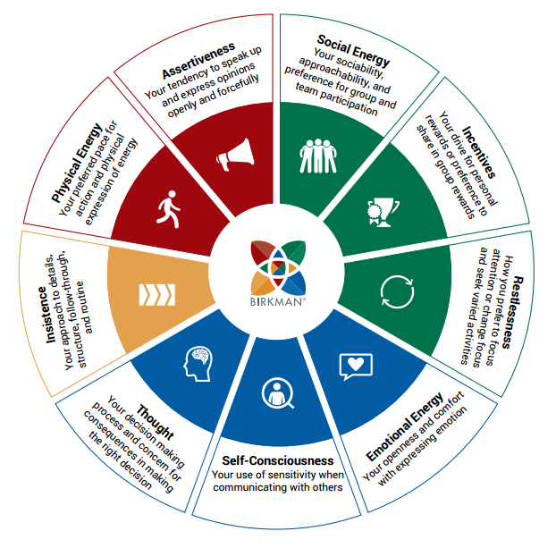
Birkman Components

Slide 18
What is a Component?
The Birkman Method describes individuals in terms of nine different behavioral Components. Each Component is expressed in terms of one’s Usual Behavior, Needs, and Stress Behavior, on both the high and low side of the scale.
Component Scale

Slide 19
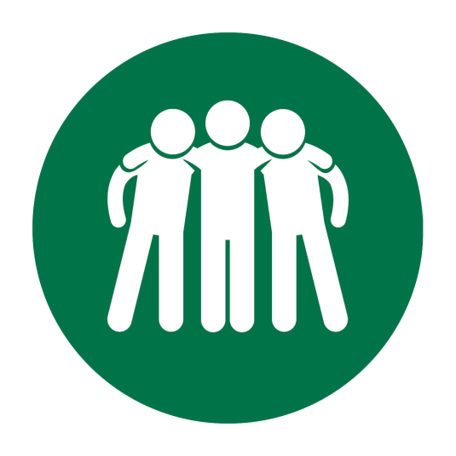
Component: Social Energy
SOCIAL ENERGY
Sociability, approachability, and preference
for group and team participation

Slide 20
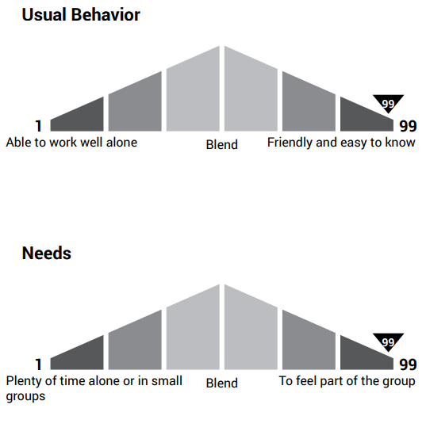
Social Energy
High Scores – Display a magnitude of Social Energy
Low Scores – Tend to conserve their Social Energy
Needs – Indicate how they recharge their Social Energy; being around people or being alone

Slide 21
Social Energy: Common Scoring Patterns
HIGHER / LOWER / LOWER
vs.
LOWER / HIGHER / LOWER
Outgoing and friendly in their usual style
Needs to be allowed to spend some time alone and be free of constant social demands
Under stress, may withdraw from people or appear unfriendly
Selectively social and works well alone
Energized by group activities and group acceptance
Under stress, may withdraw and appear unsociable or frustrated with the group

Slide 22
Example Component: Physical Energy
PHYSICAL ENERGY
Your preferred pace for action and physical
expression of energy

Slide 23
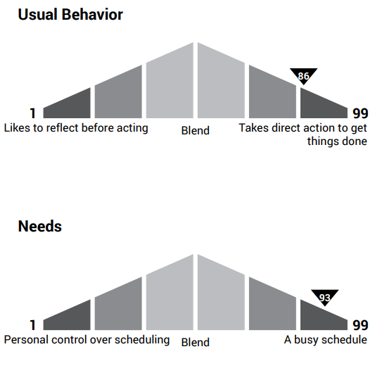
Physical Energy
High Scores – Appears physically active and busy
Low Scores – Can still be active, though they will seem less physically active and more thoughtful
Needs – Indicate how they recharge Physical Energy; being active or being still

Slide 24
Physical Energy: Common Scoring Patterns
HIGHER / LOWER / LOWER
vs.
LOWER / HIGHER / LOWER
Physically active and works at a high energy level
Needs the freedom to set their own schedule or include recharge time
Under stress can delay needed action and put things off until too late.
Conserves energy and plans before acting
Thrives in a busy work environment
Under stress, may delay action or become physically exhausted.

Slide 25
Component: Emotional Energy
EMOTIONAL ENERGY
Openness and comfort with expressing emotion

Slide 26
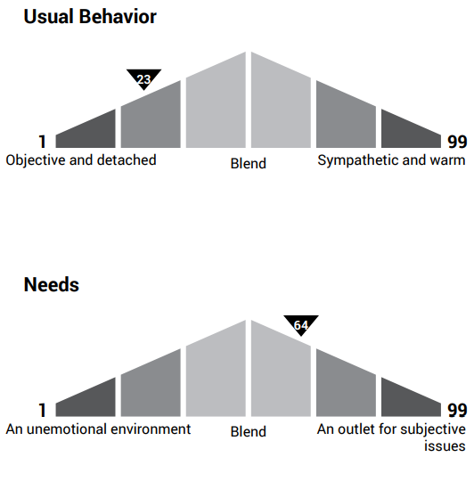
Emotional Energy
High Scores – More expressive of both positive and negative emotions
Low Scores – Tend to regulate their emotions
Needs – Indicate how to recharge Emotional Energy; being objective or expressing emotion

Slide 27
Emotional Energy: Common Scoring Patterns
HIGHER / LOWER / HIGHER
vs.
LOWER / HIGHER / HIGHER
Enjoys listening to the problems of others and is easy to confide in
Needs peers to provide logical solutions to issues
Under stress, may match their surroundings with excessive emotions
Focuses on practical results in getting things done
Needs the opportunity to share inner feelings, both positive and negative
Under stress, will allow emotions to affect judgment

Slide 28
Component: Self-Consciousness
SELF-CONSCIOUSNESS
Use of sensitivity when communicating with others

Slide 29
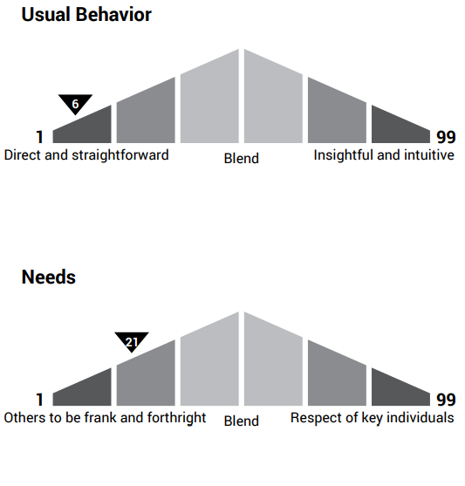
Self-Consciousness
High Scores – More aware of feelings, careful and diplomatic in relationships
Low Scores – Straightforward, direct, and matter-of-fact
Needs – Indicate how they prefer others to communicate with them; being direct or more conscious of feelings

Slide 30
Self-Consciousness: Common Scoring Patterns
LOWER / HIGHER / HIGHER
vs.
HIGHER / LOWER / HIGHER
Candid and direct in their usual style
Needs to feel the genuine respect and appreciation of others when getting feedback from others
Under stress, may become sensitive and easily embarrassed when they feel disrespected
Self-monitoring and aware in communication style
Needs frankness and candor from others
Under stress, may become evasive or overly sensitive

Slide 31
Component: Assertiveness
ASSERTIVENESS
Tendency to speak up and
express opinions openly and forcefully

Slide 32
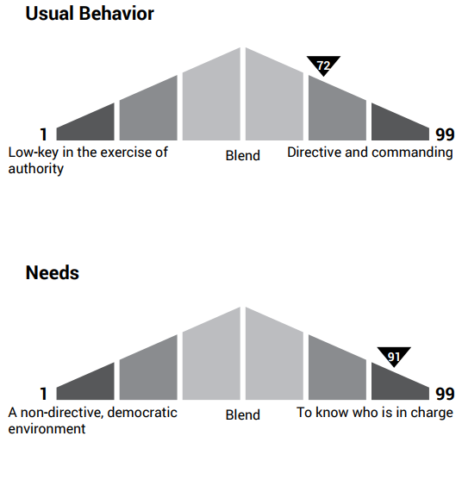
Assertiveness
High Scores – More open in sharing differences of opinion, verbally dominant
Low Scores – Deferent and agreeable, suggests rather than dominates
Needs – Indicate how they prefer others to express opinions; open and forcefully, or more suggestive

Slide 33
Assertiveness: Common Scoring Patterns
LOWER / HIGHER / HIGHER
vs.
HIGHER / LOWER / HIGHER
Pleasant and agreeable when directing others
Needs an environment where the issues are debated openly
Under stress, may tend to confront others and demonstrate a domineering attitude
Operates with firm direction and openly expresses differences of opinion
Prefers that others approach with suggestions rather than orders
Under stress, may become domineering or verbally aggressive

Slide 34
Component: Insistence
INSISTENCE
Approach to details, structure,
follow-through, and routine

Slide 35
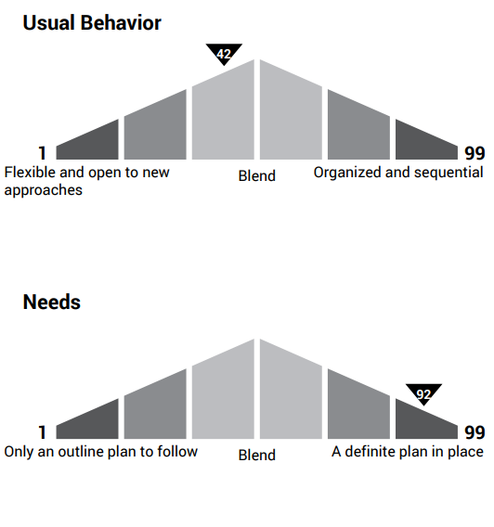
Insistence
High Scores – Structured and attentive to detail
Low Scores – Spontaneous and able to adapt easily to change
Needs – Indicate our preference for routine and detail; flexible or structured

Slide 36
Insistence: Common Scoring Patterns
LOWER / HIGHER / HIGHER
vs.
HIGHER / LOWER / LOWER
Comfortable with changing plans and easily adapts to accommodate them
Needs clear and detailed instructions despite the change
Under stress, may refuse to deviate from the process, even if doing so is a necessity
Works in a consistent and predictable manner
Prefers a broad outline to follow with minimal routine
Under stress, may become frustrated with the rules and become disorganized

Slide 37
Component: Incentives
INCENTIVES
Drive for personal rewards or preference
to share in group reward

Slide 38
Incentives
High Scores – Eager to compete and opportunity minded
Low Scores – Team-spirited and considers the well-being of others
Needs – Indicate preference for rewards; person or group

Slide 39
Incentives: Common Scoring Patterns
LOWER / HIGHER / HIGHER
vs.
HIGHER / LOWER / LOWER
Team-oriented and focuses on long-term rewards such as motivation
Needs an environment which rewards individual achievement
Under stress, may become self-promotional and overly competitive
Opportunity-minded and tends to naturally bargain and sell
Needs to work alongside other people who value trust
Under stress, can feel taken advantage of when forced to negotiate

Slide 40
Component: Restlessness
RESTLESSNESS
Preference to focus attention or
change focus and seek varied activities

Slide 41
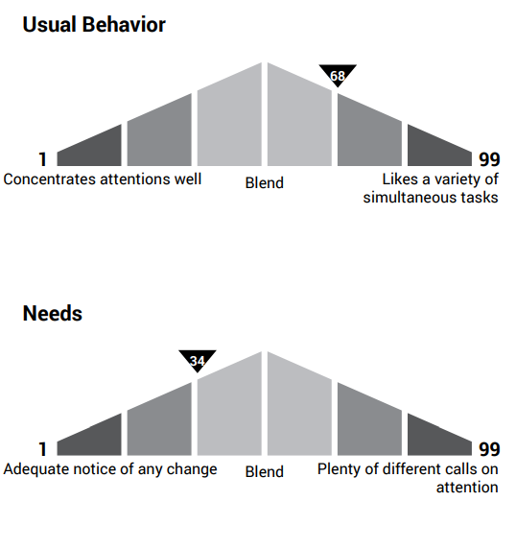
Restlessness
High Scores – More attentive to surroundings and ready to start new ideas
Low Scores – Concentrative and focused, attentive to the task at hand
Needs – Indicate how they direct attention; focused on one or several projects

Slide 42
Restlessness: Common Scoring Patterns
LOWER / HIGHER / HIGHER
vs.
HIGHER / LOWER / HIGHER
Concentrative and patient with long-term projects
Needs frequent changes in activity and relief from daily routine
Under stress, may have difficulty concentrating or become annoyed by delays
Initiates frequent changes and easily shifts attention when interrupted
Needs a minimum of interruptions and an adequate notice of change
Under stress, may become annoyed by delays or find it hard to sit still

Slide 43
Component: Thought
THOUGHT
Decision making process and concern
for consequences in making the right decision

Slide 44
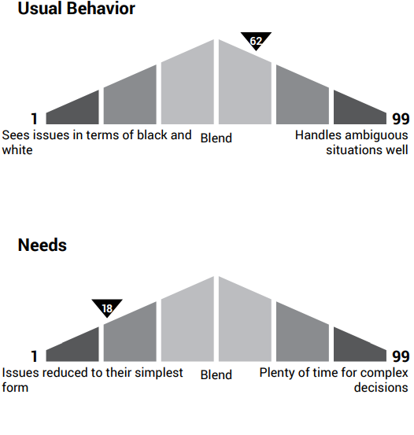
Thought
High Scores – More thoughtful and reflective
Low Scores – Tend to grasp situations quickly and are decisive in action and thought
Needs – Indicate how they make decisions; quickly, or prefers time to consider all options

Slide 45
Thought: Common Scoring Patterns
LOWER / HIGHER / HIGHER
vs.
HIGHER / LOWER / HIGHER
Decisive in thought and action, tends to be matter-of-fact in thinking
Needs more time to reflect upon decisions
Under stress, may postpone making a decision or become overly anxious about making decisions
Thoughtful, reflective, and values depth of decisions
Needs minimal ambiguity and the freedom to take immediate action
Under stress, may postpone making a decision or become overly anxious about making decisions

